Slide 1
Cyber Security GUIDE AND AWARENESS

Slide 2

Who am I?

Slide 3

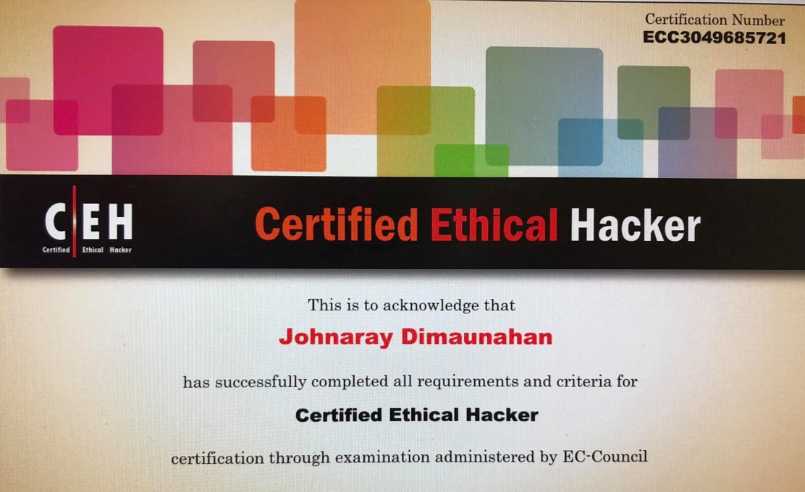
Johnaray Dimaunahan
Former Head of Cyber Security – Avyan PH
WPS IT Support Engineer – TMF Philippines Inc.
Former DPO - Aesthetic Science Clinic

Slide 4

LETS GET STARTED BY KNOWING THE PARTICIANTS

Slide 5
TIMELINE
First Philippine Internet connection was made March 29, 1994
March 29, 1994, 1:15 a.m.: Benjie Tan, who was working for ComNet, a company that supplied Cisco routers to the Philnet project, established the Philippine's first connection to the Internet at a PLDT network center in Makati City. Shortly thereafter, he posted a short message to the Usenet newsgroup soc.culture.filipino to alert Filipinos overseas that a link had been made. His message read:
"As of March 29,1994 at 1:15 am Philippine time, unfortunately 2 days late due to slight technical difficulties, the Philippines was FINALLY connected to the Internet via SprintLink. The Philippine router, a Cisco 7000 router was attached via the services of PLDT and Sprint communications to SprintLink's router at Stockton Ca. The gateway to the world for the Philippines will be via NASA Ames Research Center. For now, a 64K serial link is the information highway to the rest of the Internet world."
No Law enacted yet regarding Cyber Security

Slide 6
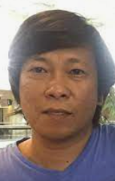
ILOVEYOU, sometimes referred to as Love Bug or Love Letter for you, is a computer worm that infected over ten million Windows personal computers on and after 5 May 2000. It started spreading as an email message with the subject line "ILOVEYOU" and the attachment "LOVE-LETTER-FOR-YOU.TXT.vbs." At the time, Windows computers often hid the latter file extension ("VBS," a type of interpreted file) by default because it is an extension for a file type that Windows knows, leading unwitting users to think it was a normal text file. Opening the attachment activates the Visual Basic script. First, the worm inflicts damage on the local machine, overwriting random files (including Office files and image files; however, it hides MP3 files instead of deleting them). Then, the worm copies itself to all addresses in the Windows Address Book used by Microsoft Outlook, allowing it to spread much faster than any other previous email worm.
Onel de Guzman, a then-24-year-old resident of Manila, Philippines, created the malware. Because there were no laws in the Philippines against making malware at the time of its creation, the Philippine Congress enacted Republic Act No. 8792, otherwise known as the E-Commerce Law, in July 2000 to discourage future iterations of such activity. However, the Constitution of the Philippines bans ex post facto laws, and as such, de Guzman could not be prosecuted.

Slide 7
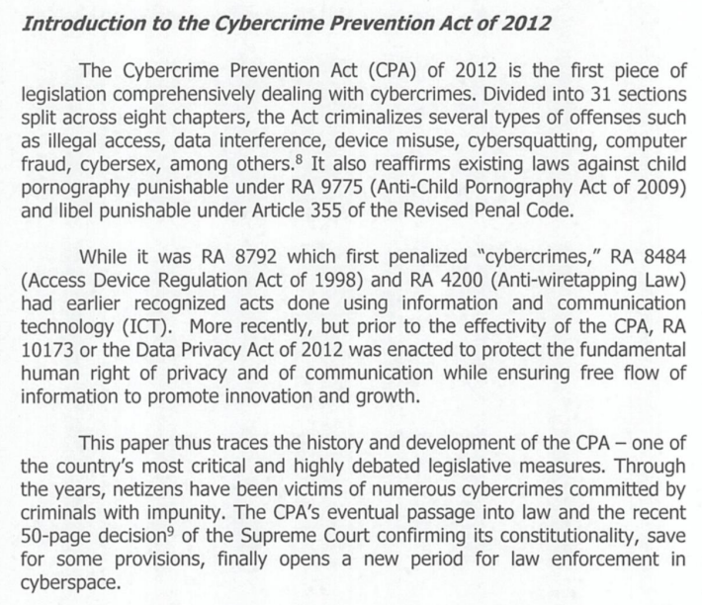
Crime Prevention Act of 2012
Short History of the Dvlpt of Cybercrime.pdf (doj.gov.ph)

Slide 8
Republic Act 10173 – Data Privacy Act of 2012
https://www.privacy.gov.ph/data-privacy-act/

Slide 9
WORK SHOP TIME
Instructions:
Group your self to 2
Lets now discuss base on the earlier discussion about basic Computing Security Concept and will try to solve
Problem 1:
A Mother of a graduate student, buy a pack of Smoked fish. She noticed that the Smoked fish is wrapped in a bond paper with some markings. To her surprise, it was her Son’s photocopy of High School Card which she recalls she submitted it to the College where her Son is currently studying. Out of shookt, she checked with the vendor only to find out that the remaining wrappings are from the College where it was sold as a scrap.

Slide 10
Problem 2:
The School Server got badly affected by a Ransomware and the Ransomware is spreading like a wild fire, all machines connected to the school network got infected.
What can the school do?

Slide 11
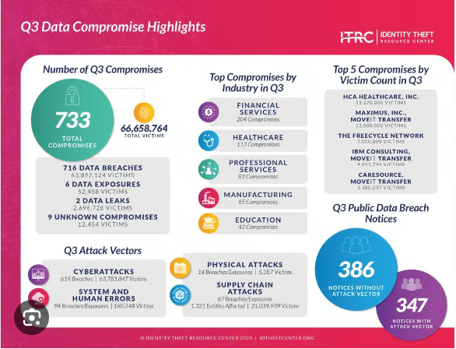

Slide 12
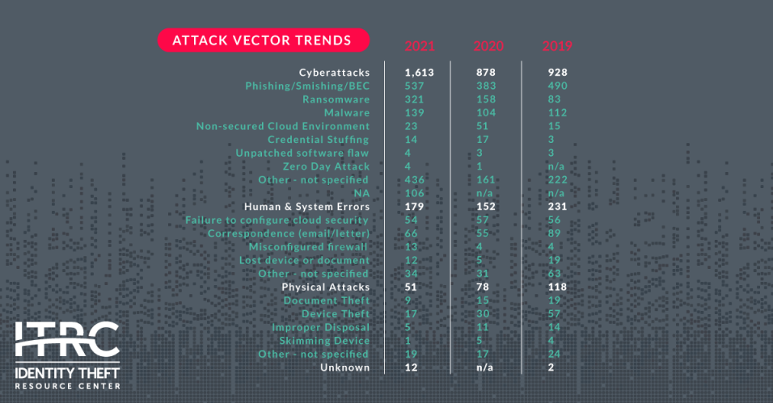

Slide 13
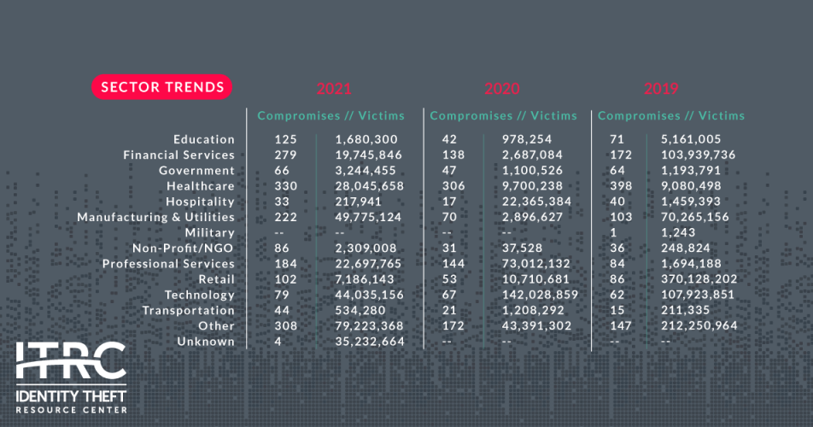

Slide 14
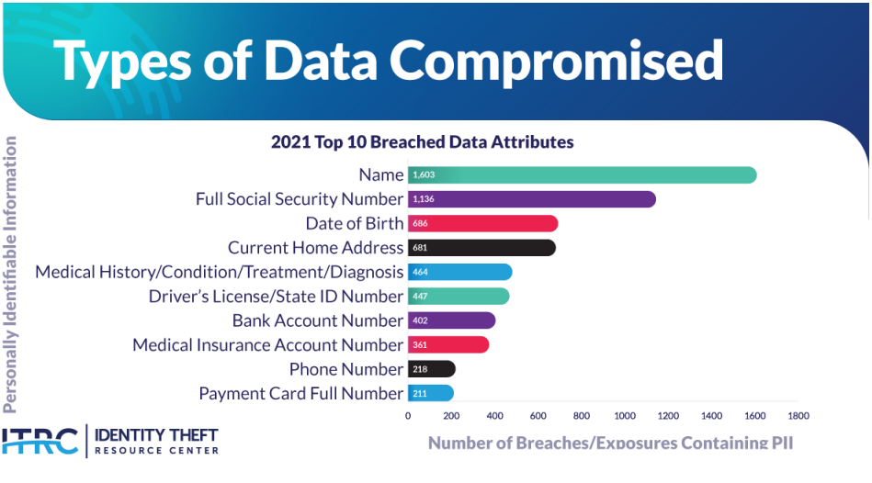

Slide 15
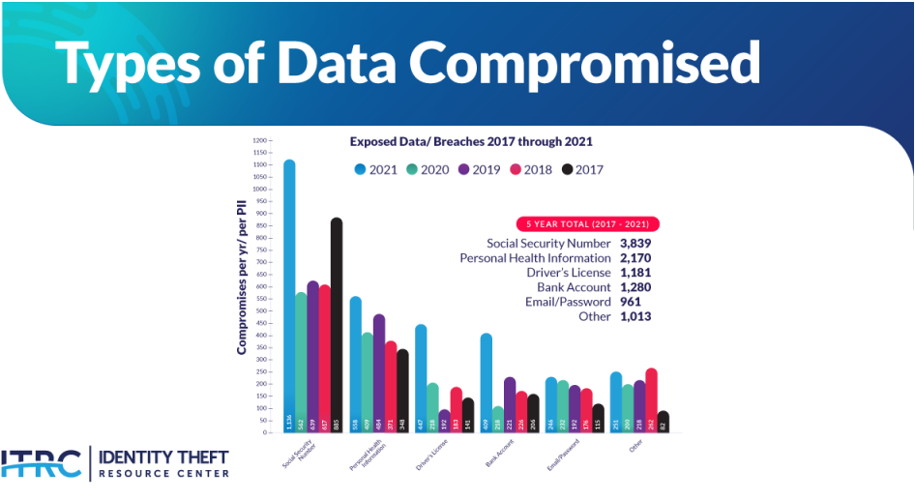

Slide 16
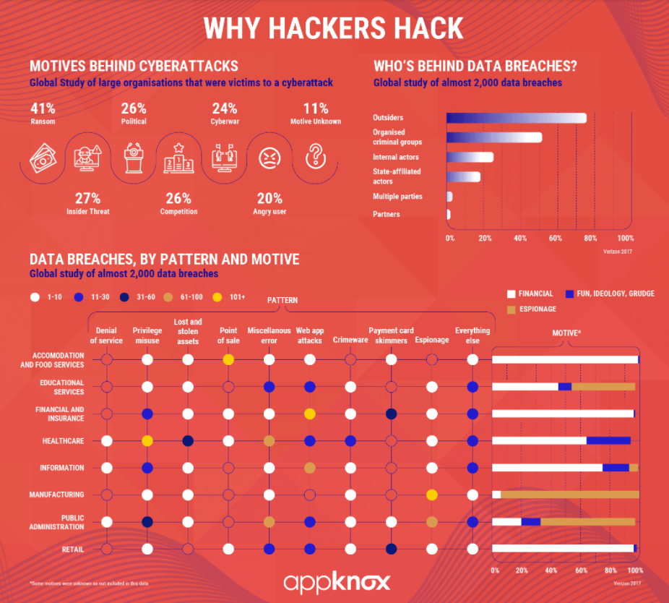

Slide 17
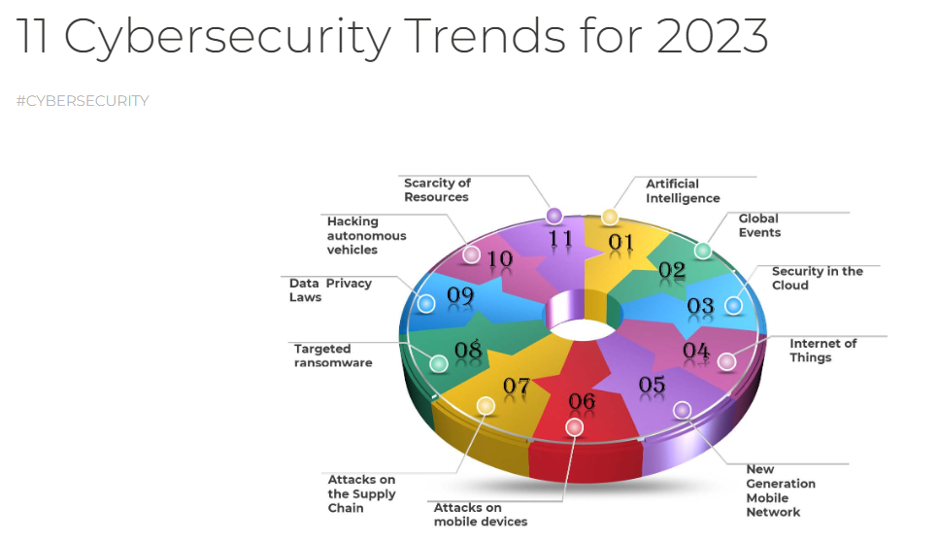

Slide 18
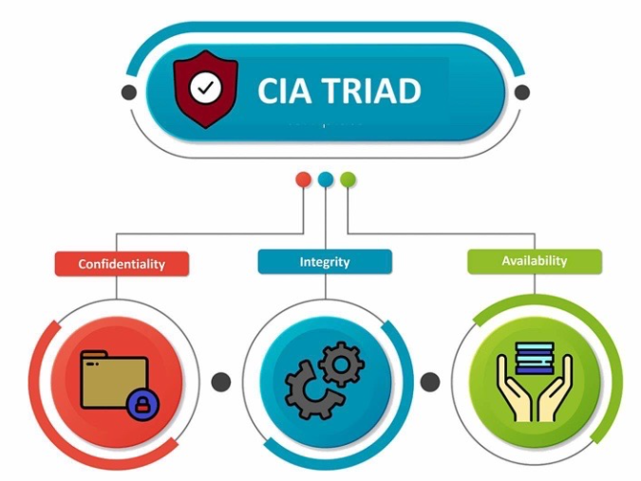

Slide 19
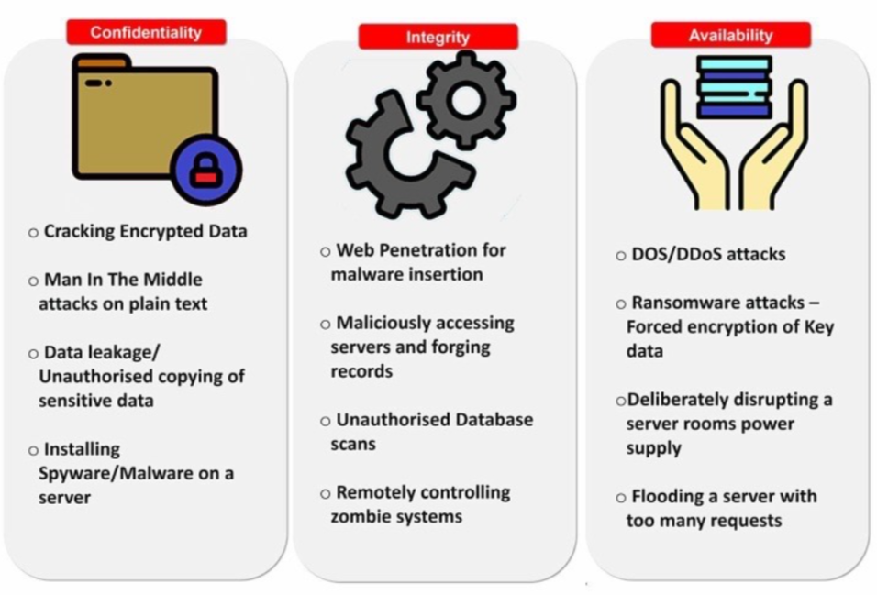

Slide 20

D – Data
I – Information
C – Communication
K - Knowledge

Slide 21
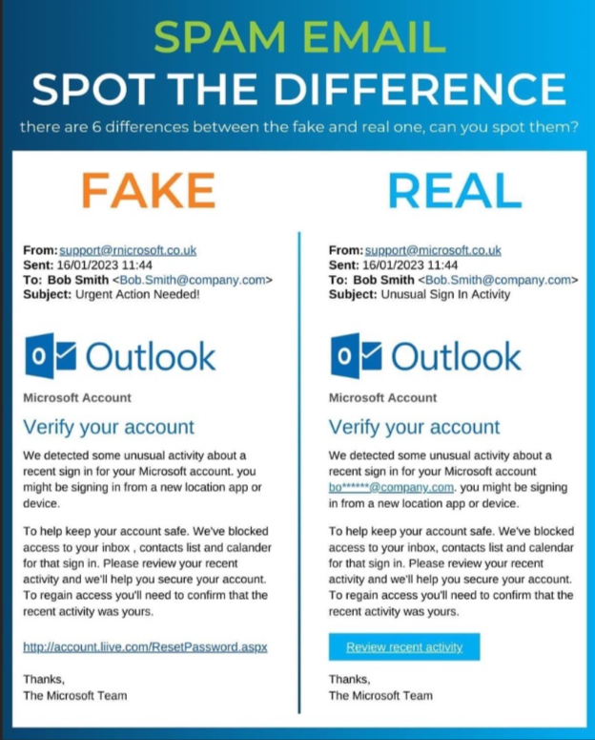

Slide 22
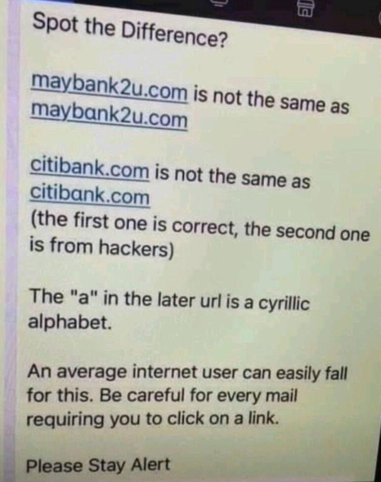

Slide 23


Slide 24
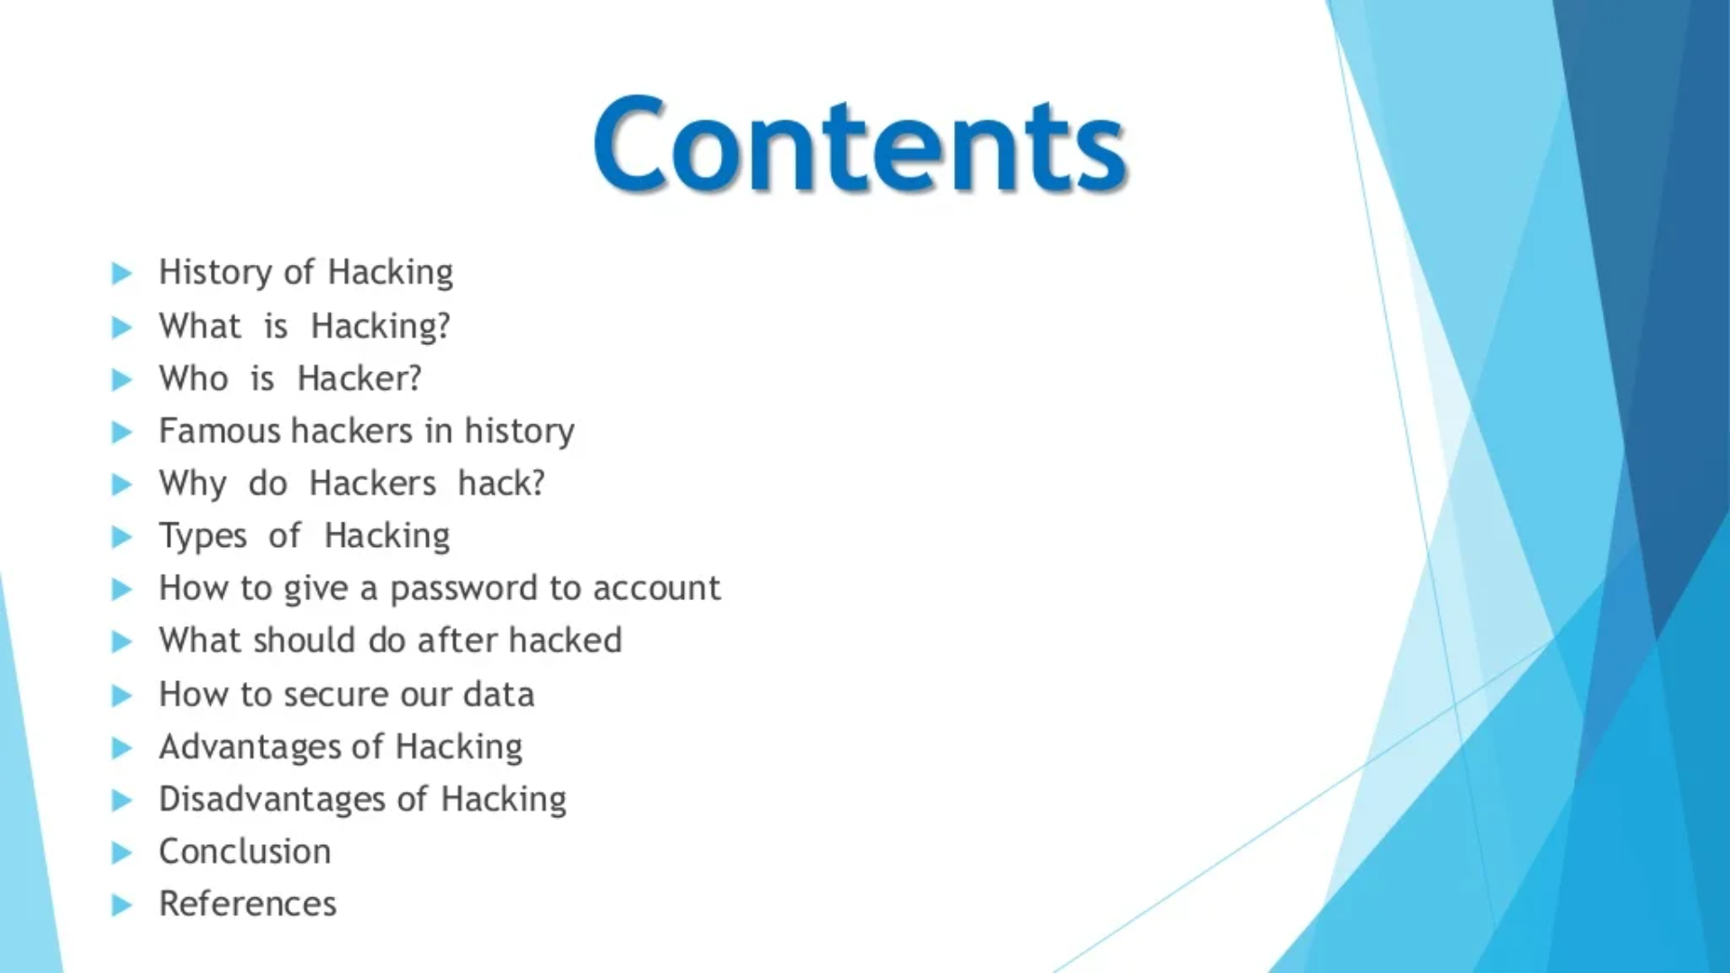

Slide 25
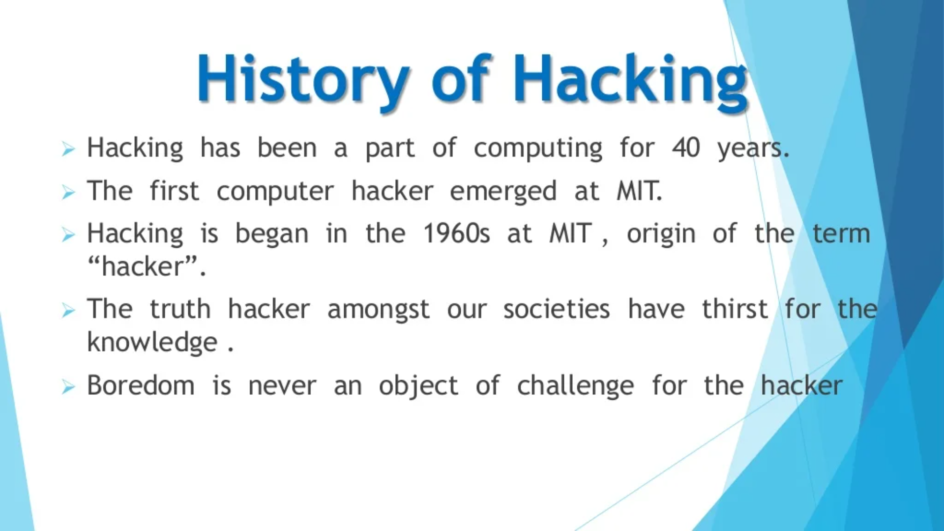

Slide 26
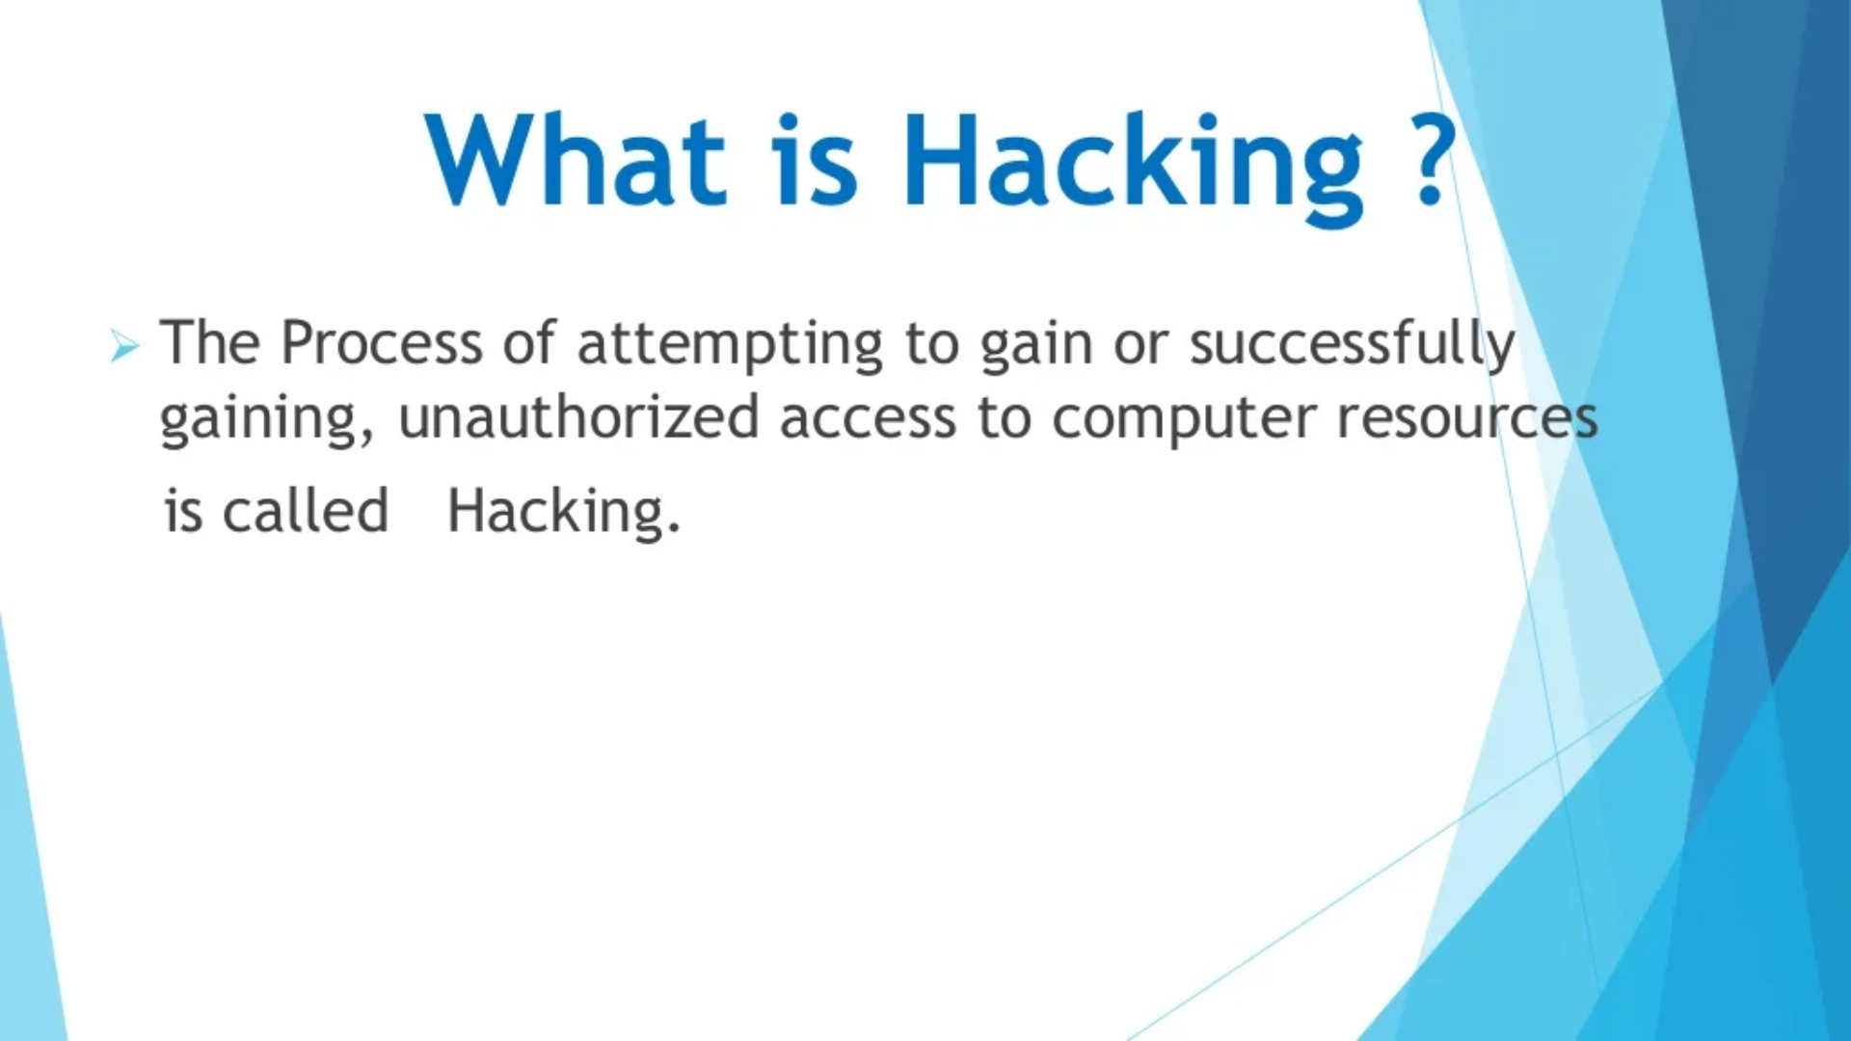

Slide 27
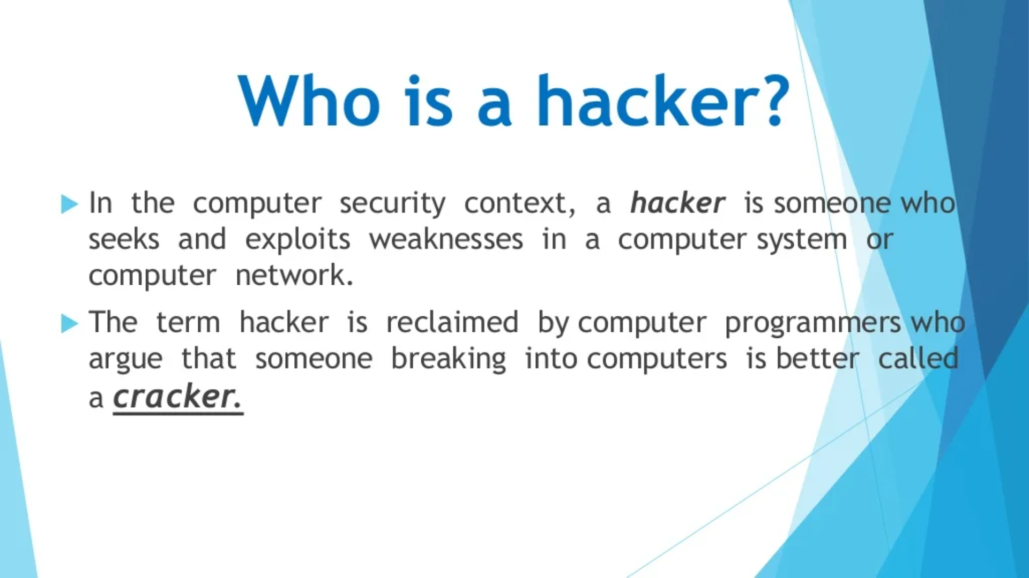

Slide 28
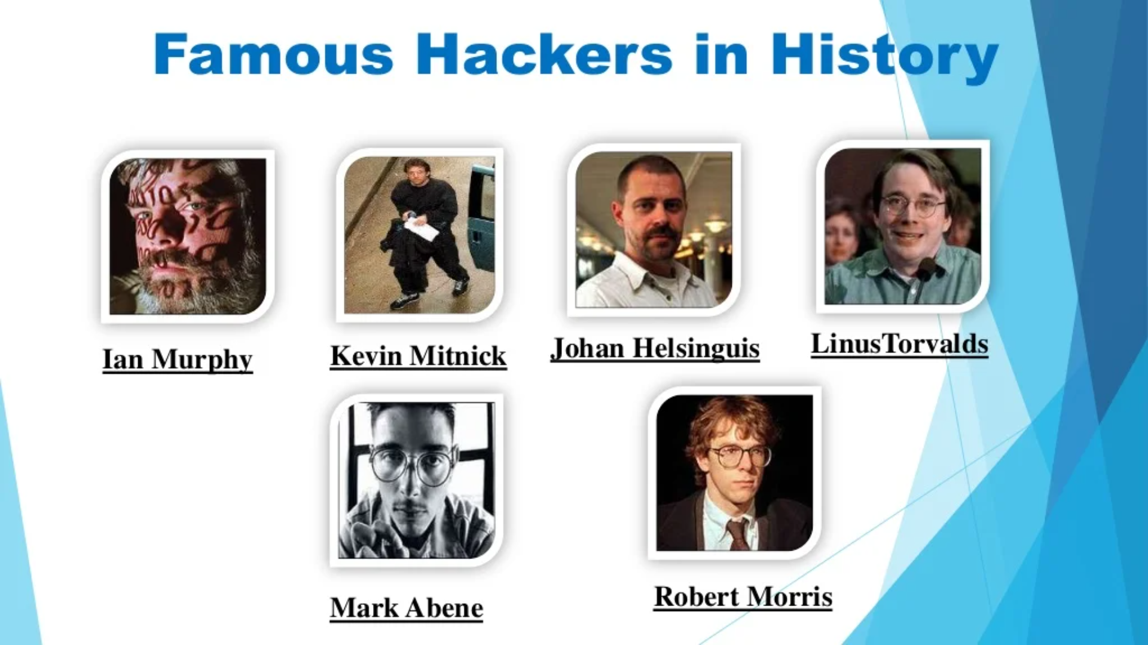

Slide 29
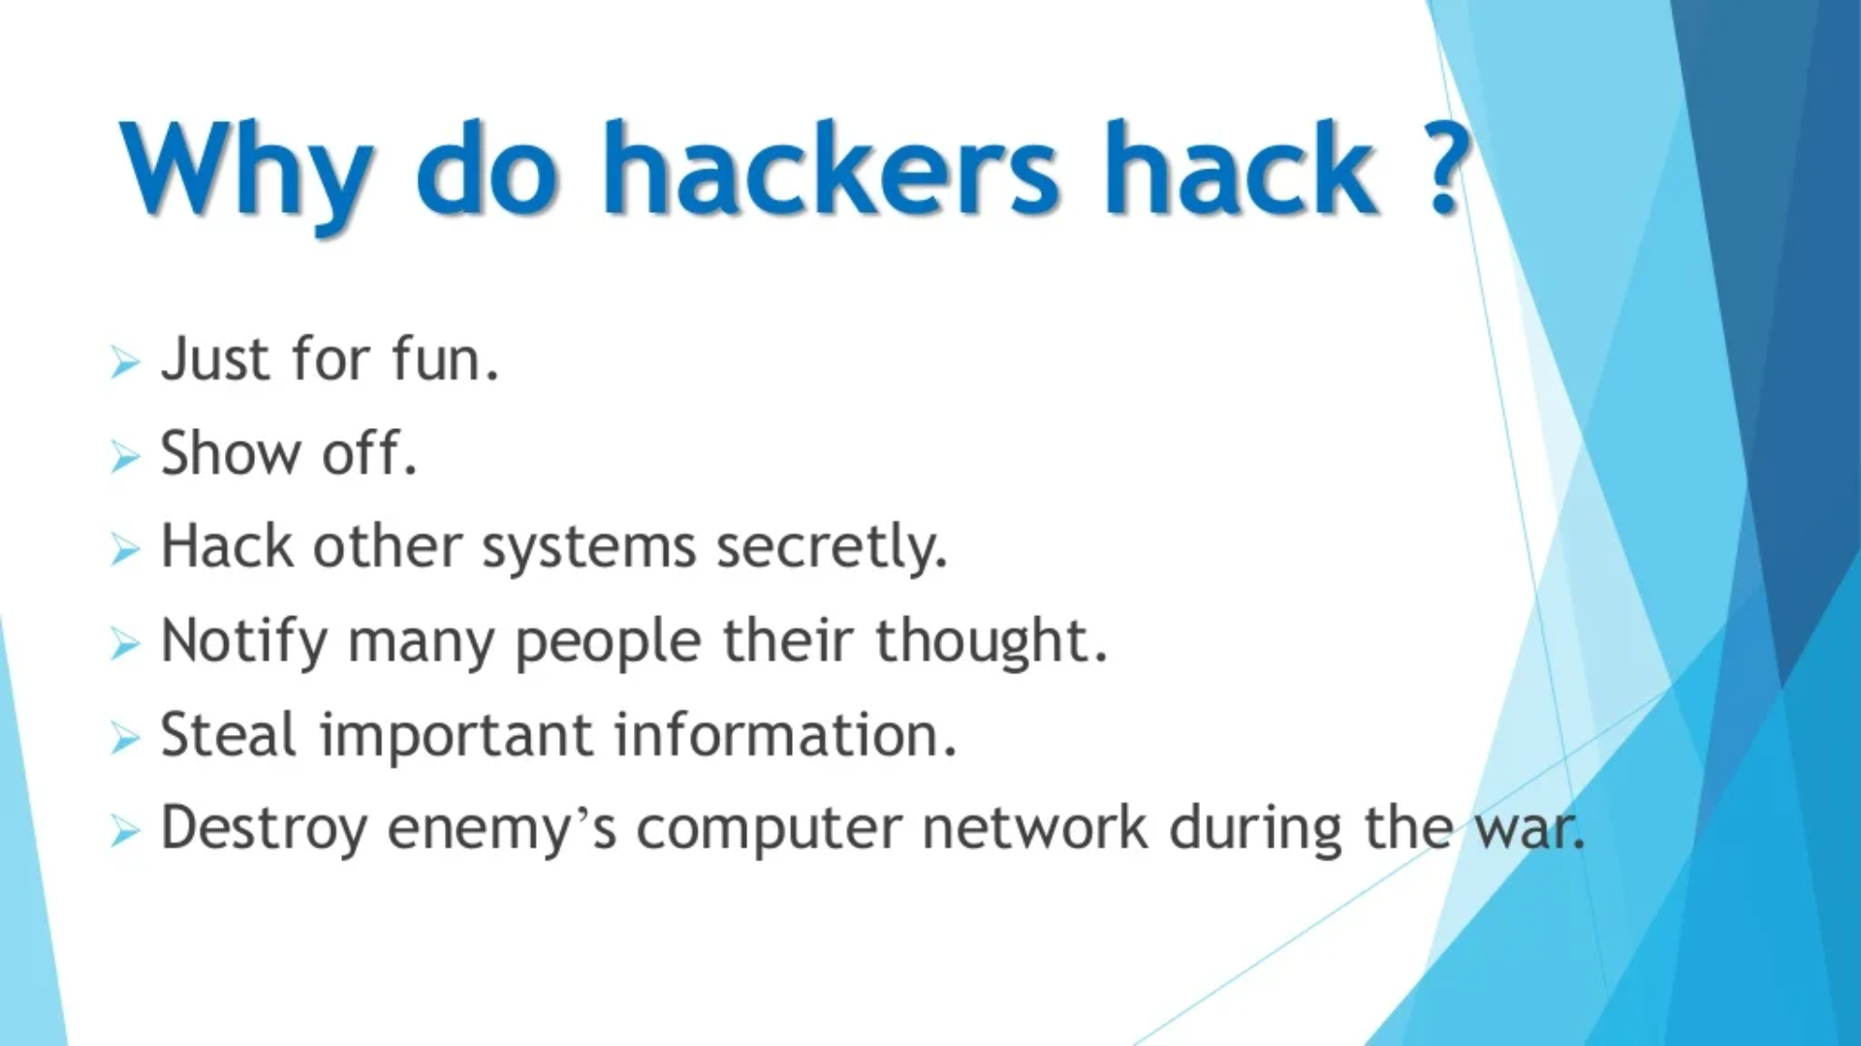

Slide 30
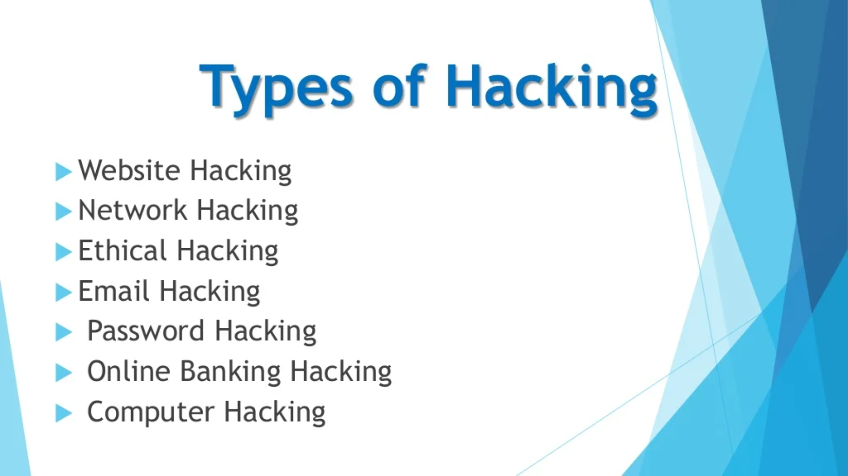

Slide 31
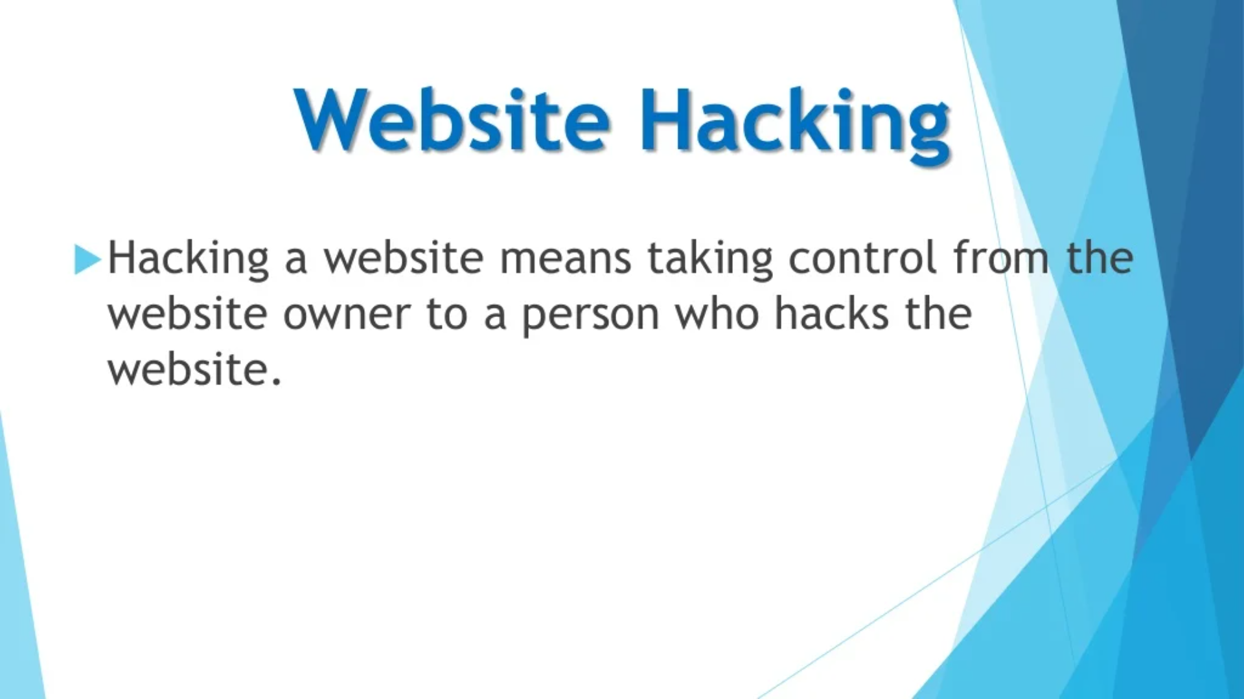

Slide 32
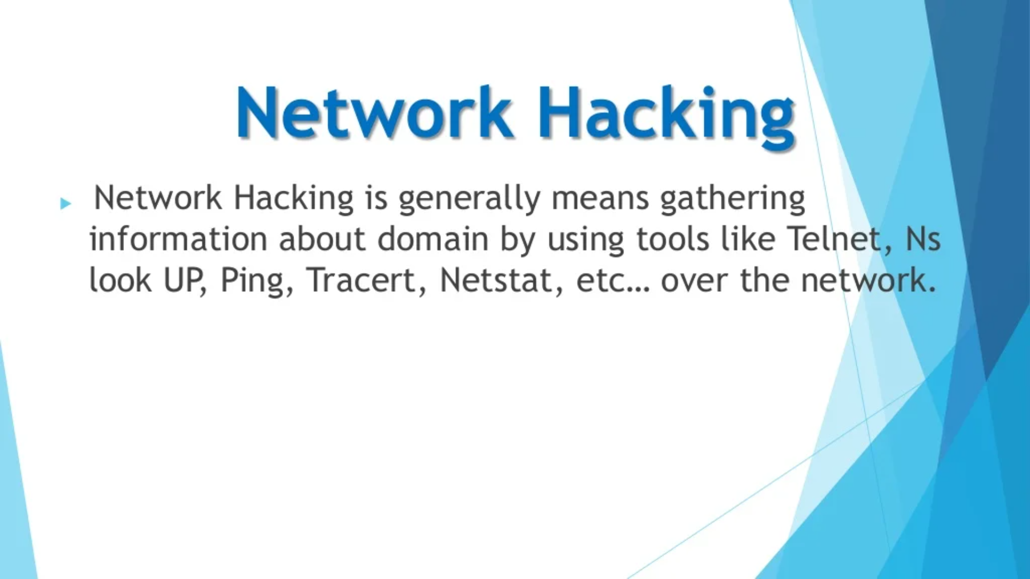

Slide 33
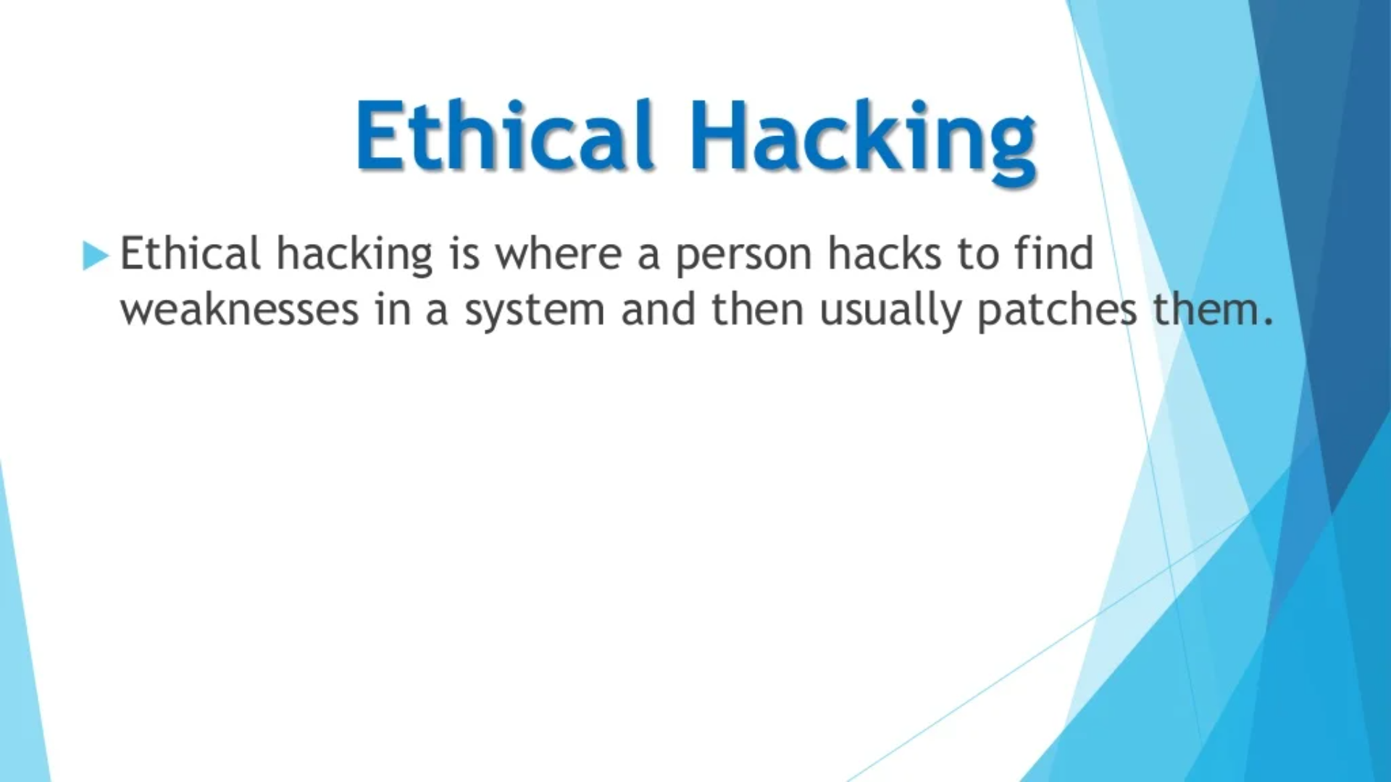

Slide 34
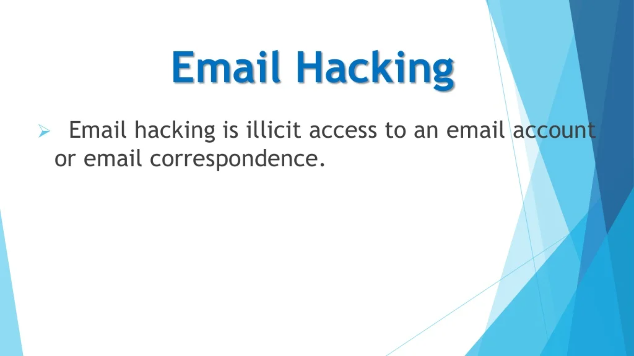

Slide 35
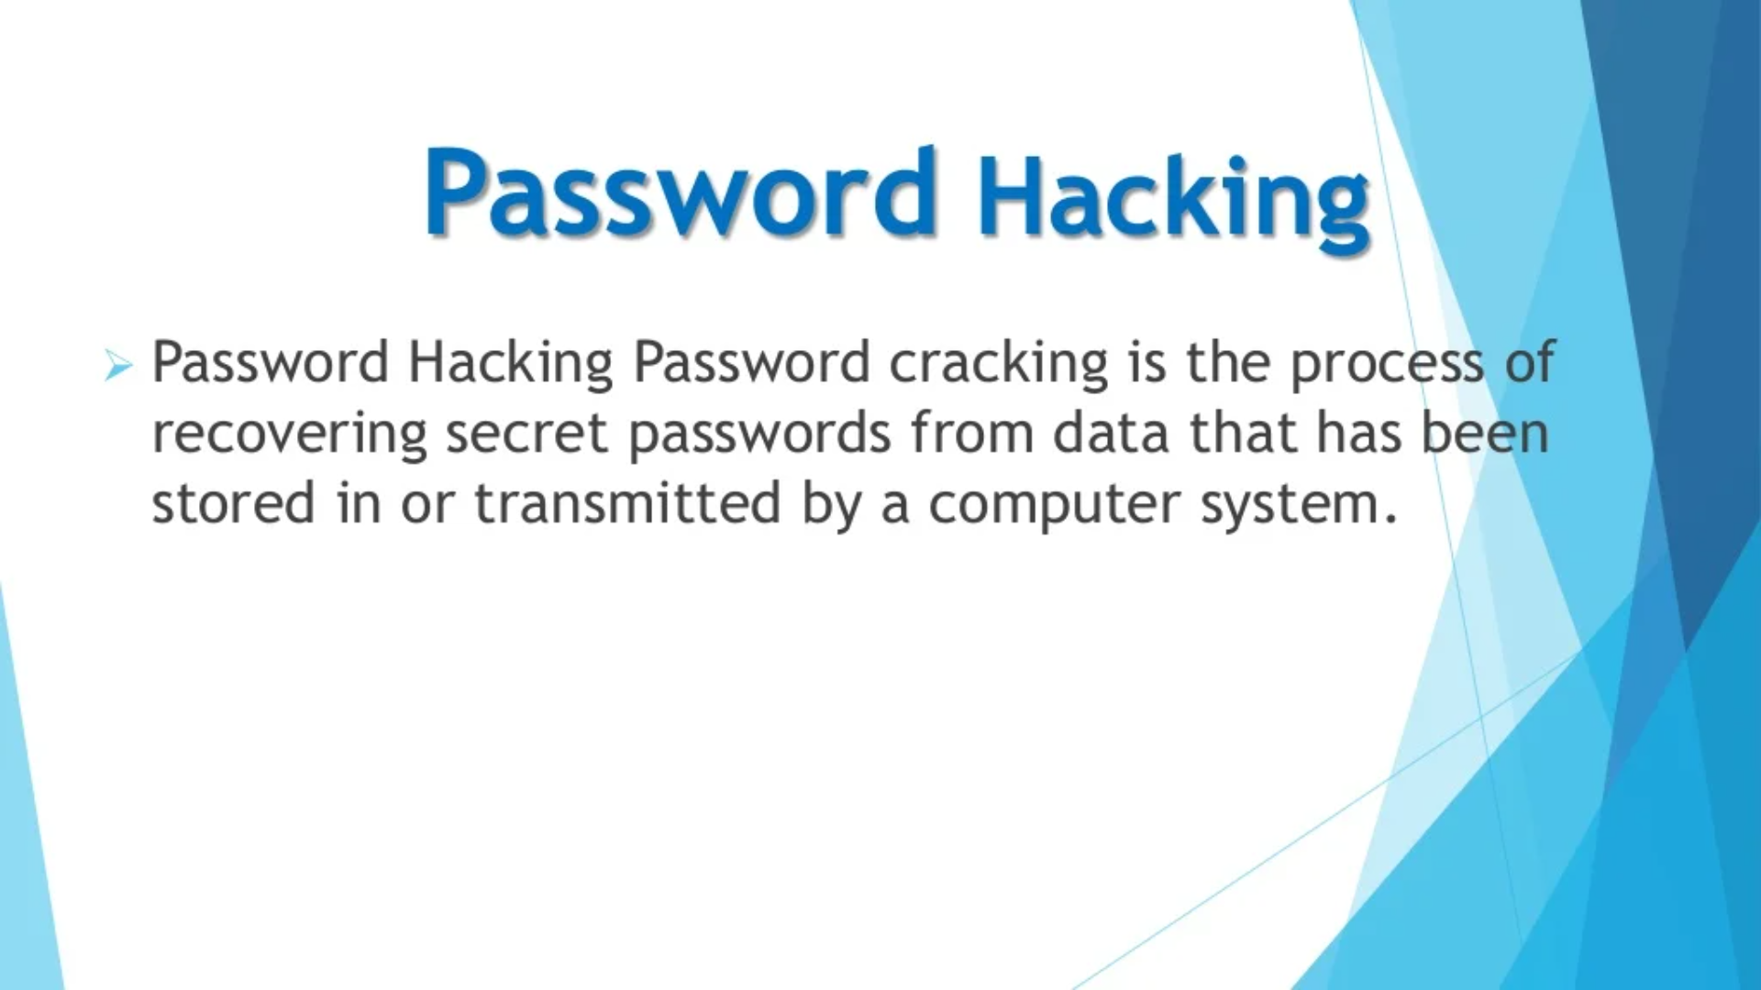

Slide 36
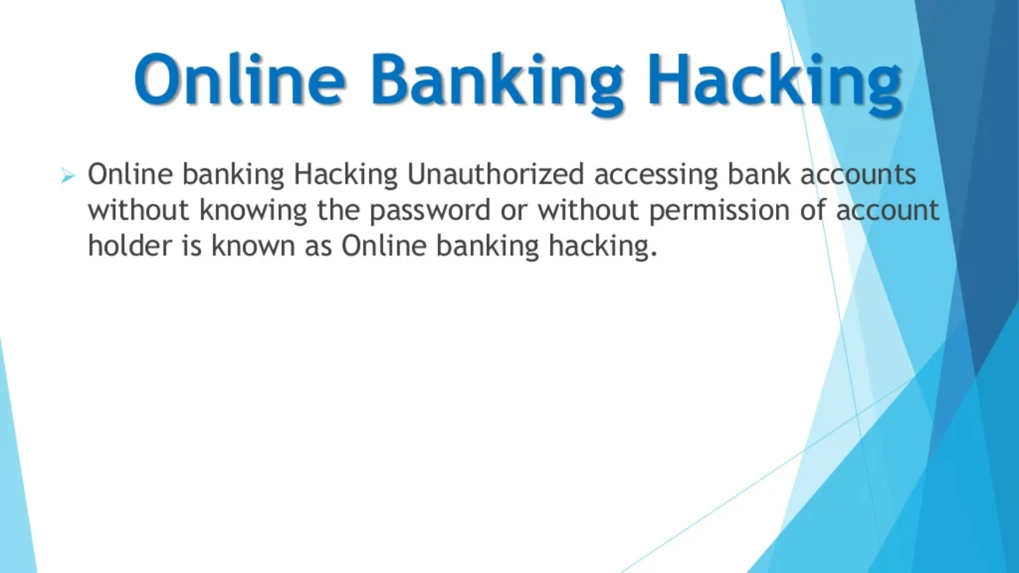

Slide 37
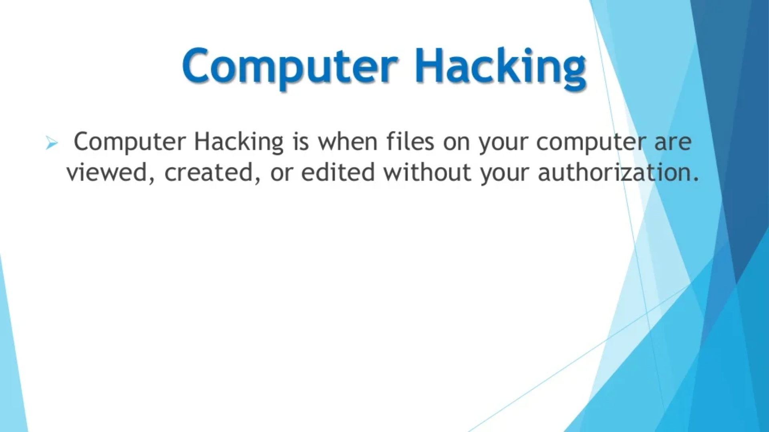

Slide 38
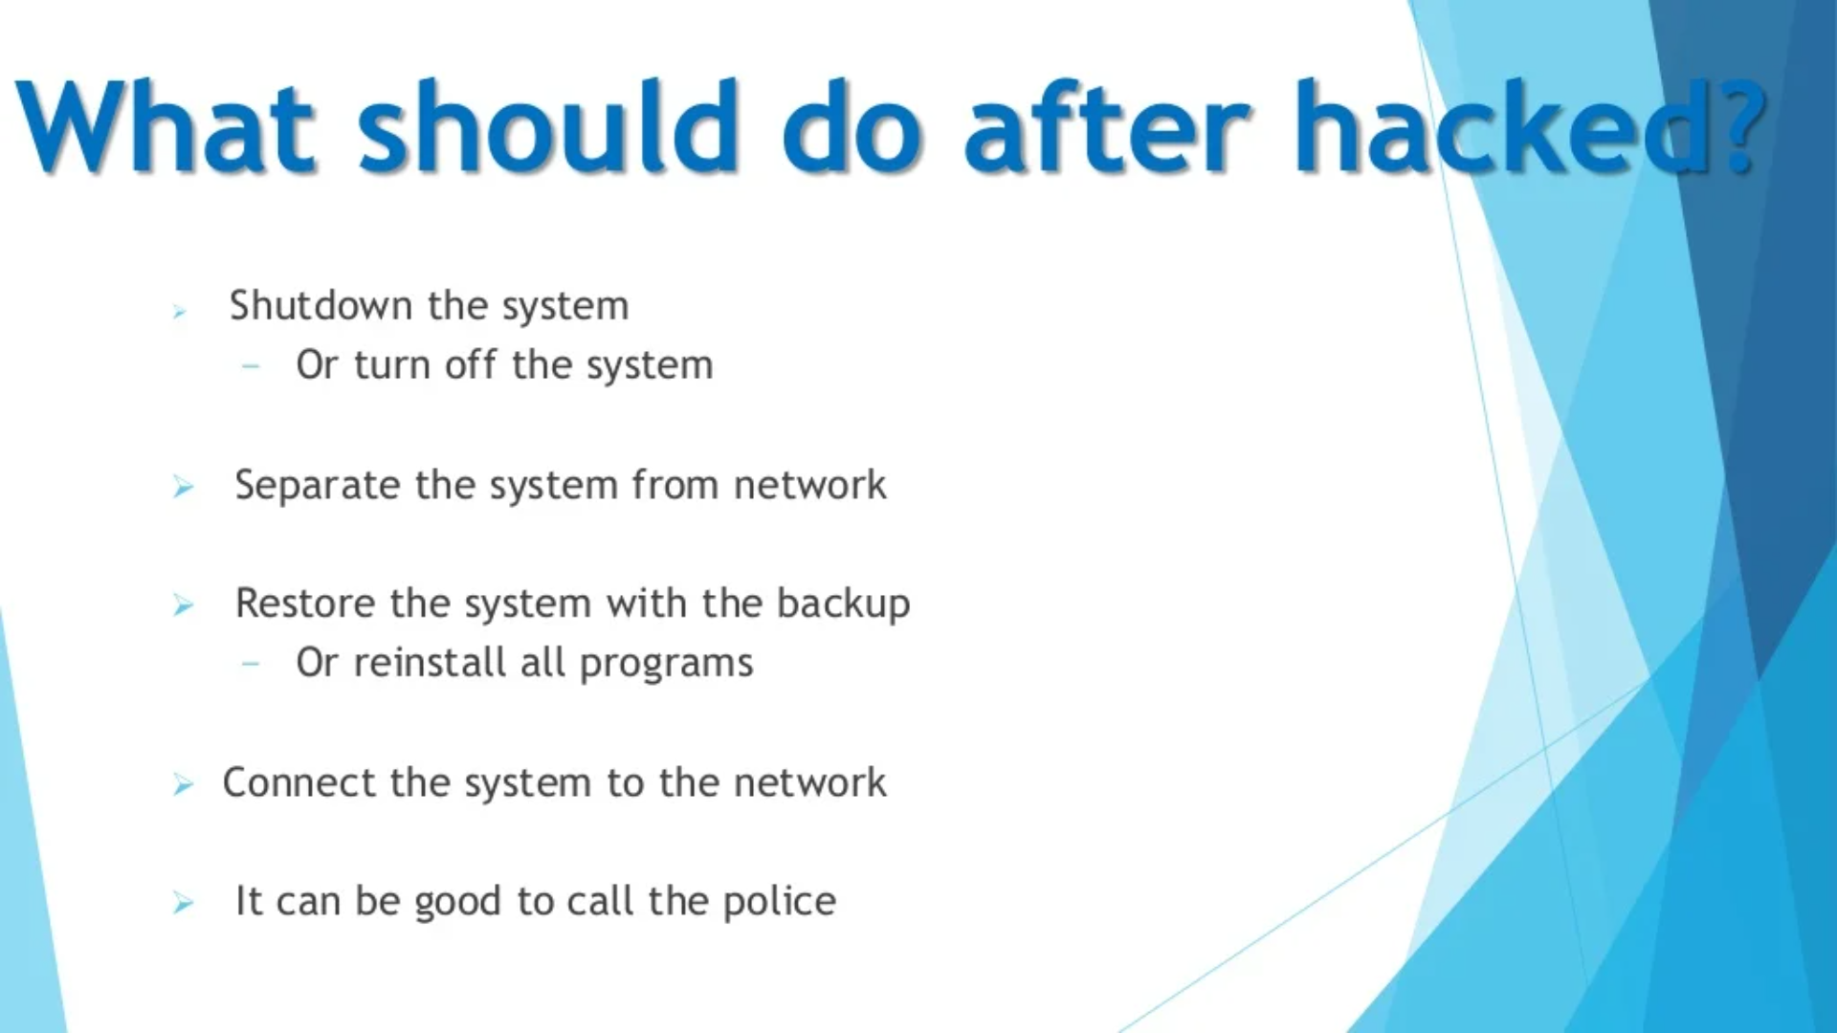

Slide 39
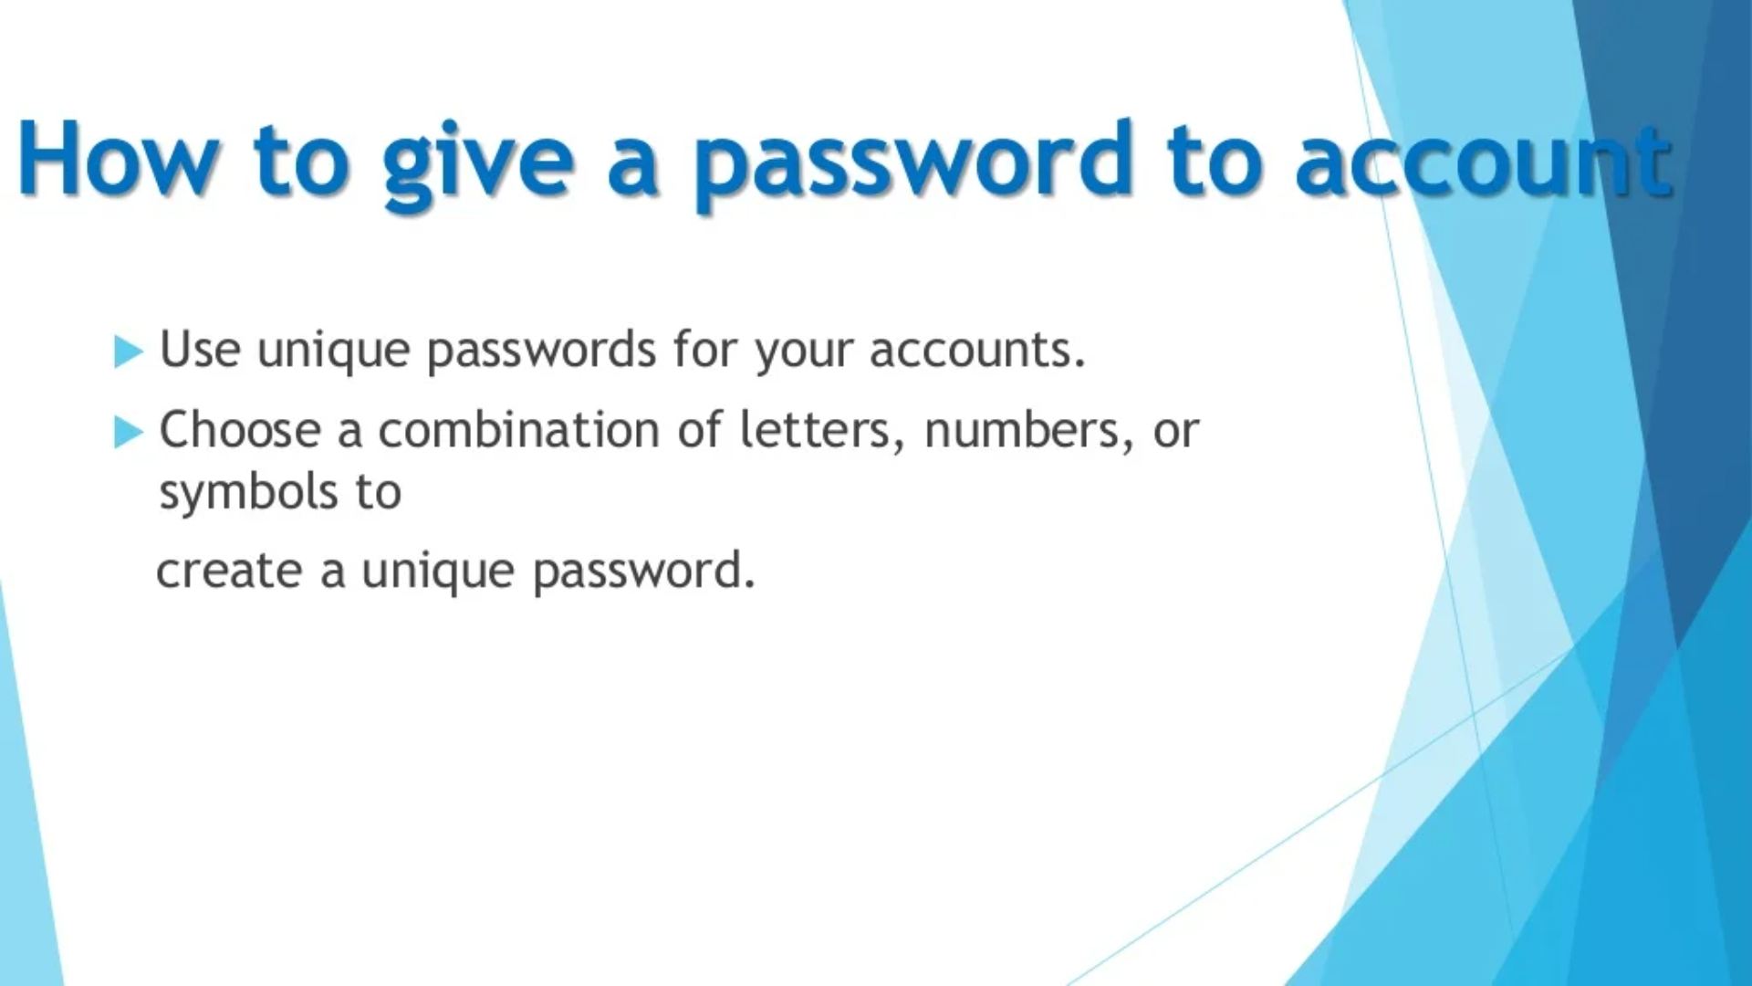

Slide 40
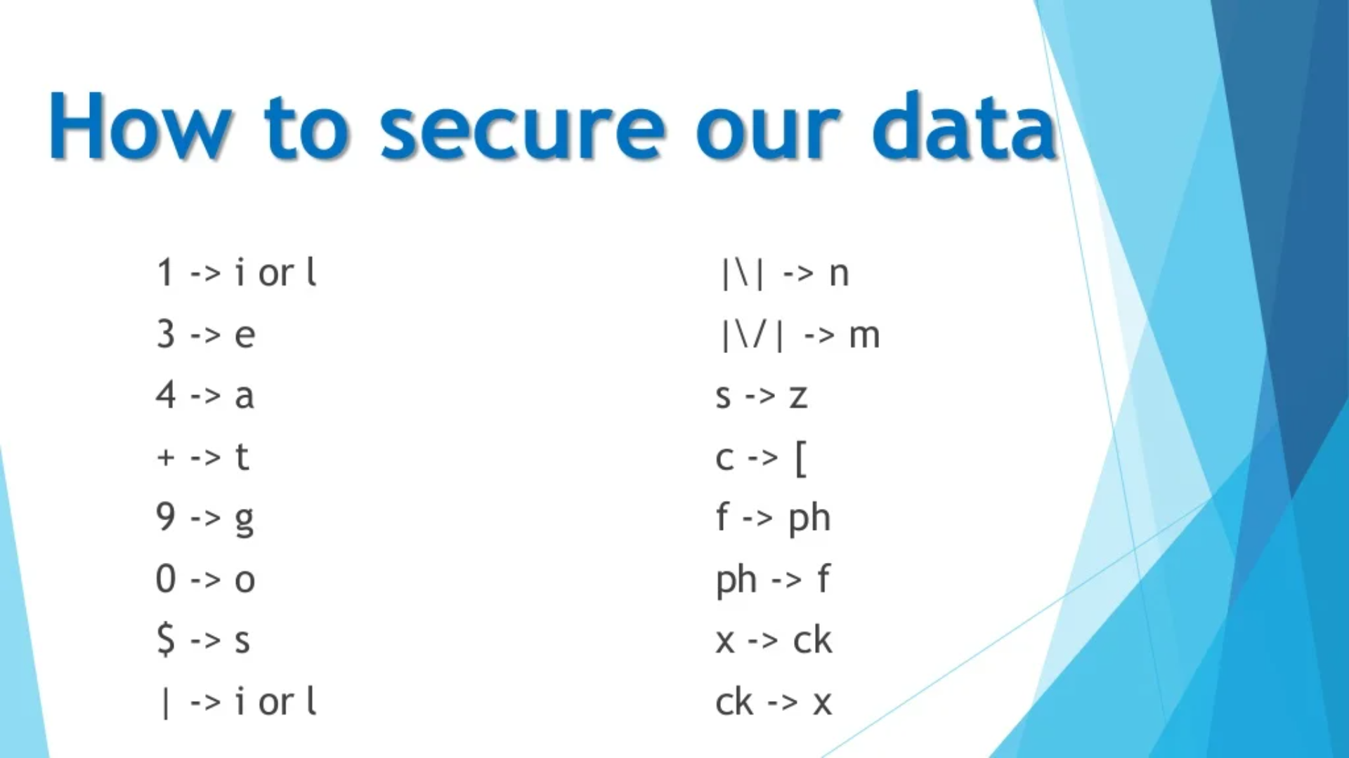

Slide 41
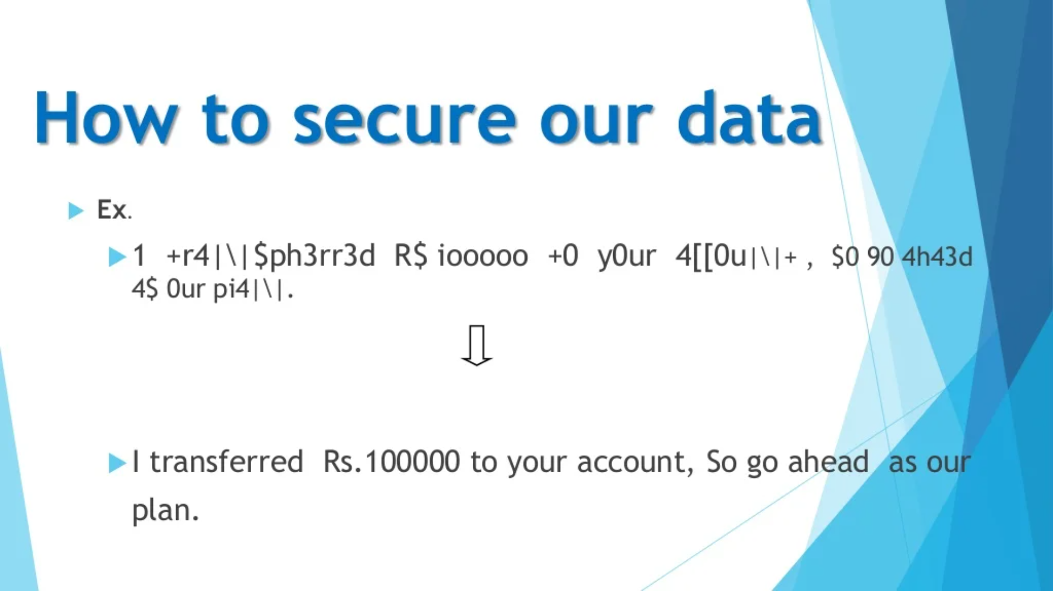

Slide 42
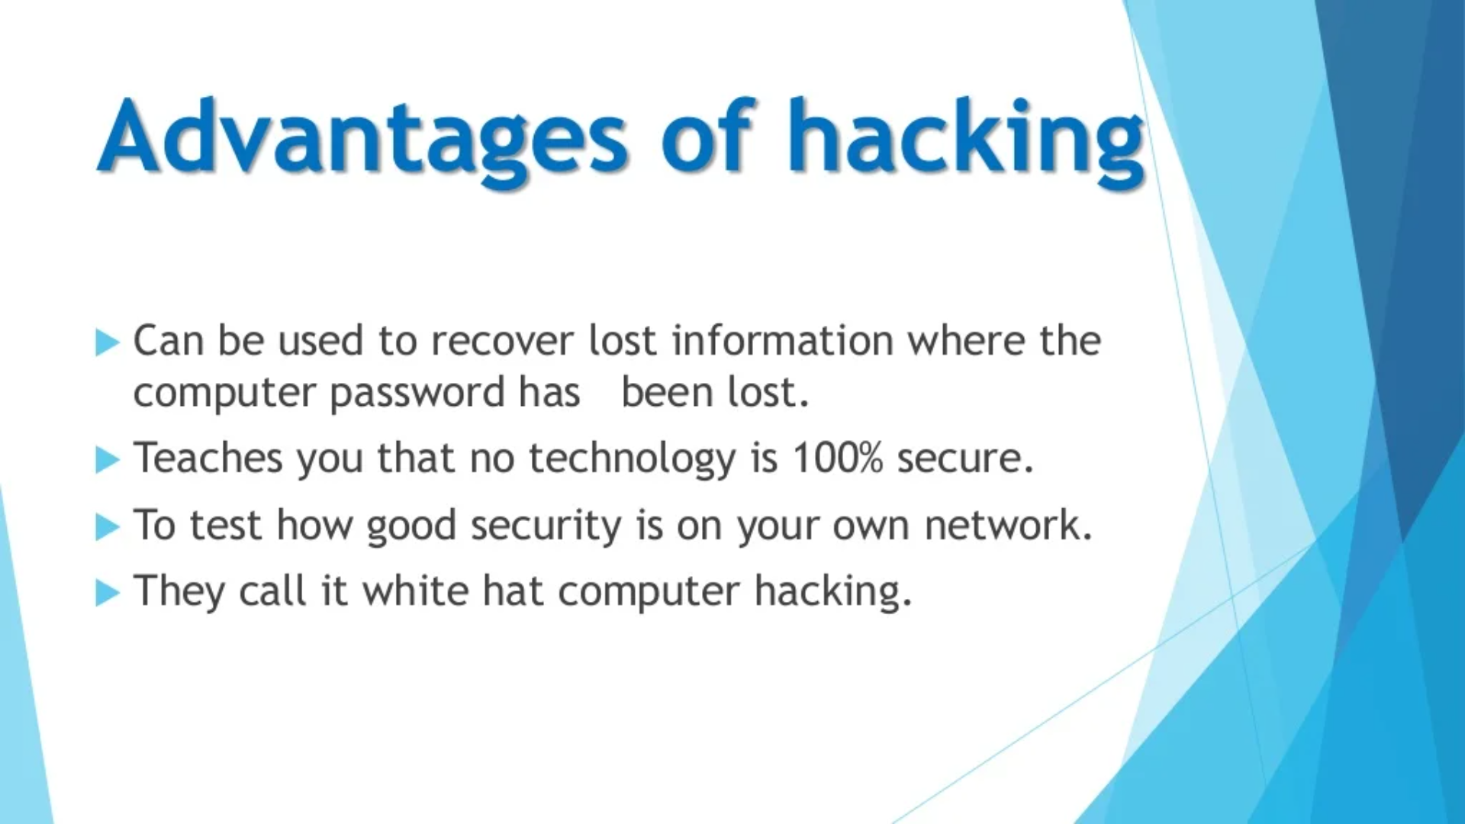

Slide 43
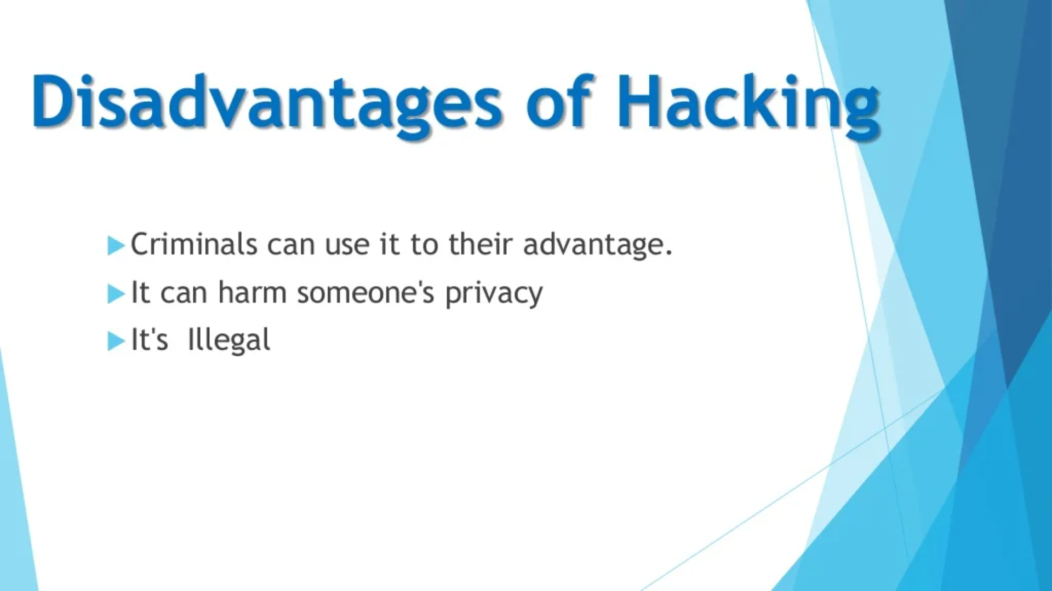

Slide 44
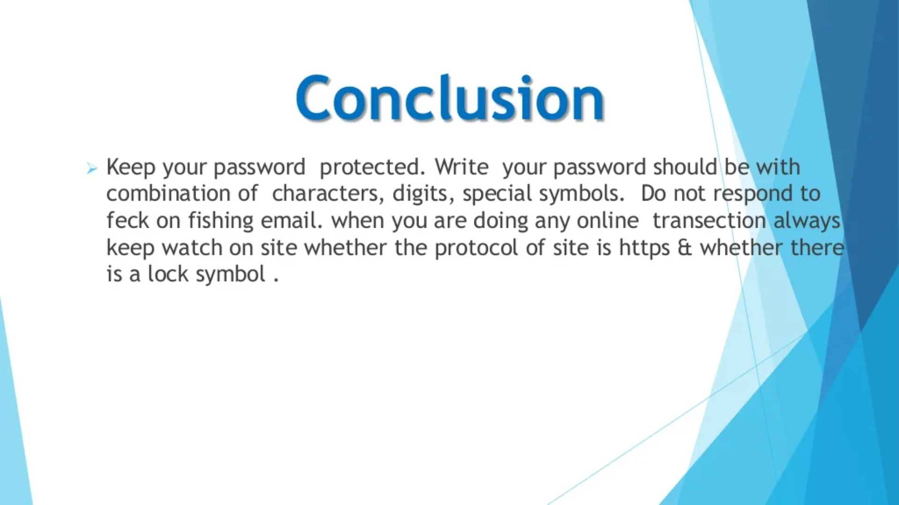

Slide 45
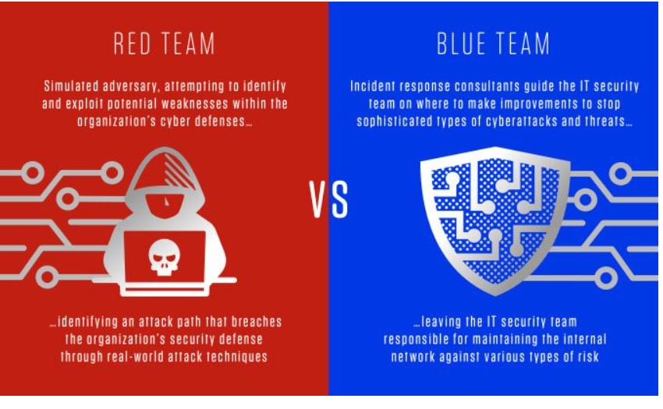

Slide 46
What is a red team
In a red team/blue team cybersecurity simulation, the red team acts as an adversary, attempting to identify and exploit potential weaknesses within the organization’s cyber defenses using sophisticated attack techniques. These offensive teams typically consist of highly experienced security professionals or independent ethical hackers who focus on penetration testing by imitating real-world attack techniques and methods.
The red team gains initial access usually through the theft of user credentials or social engineering techniques. Once inside the network, the red team elevates its privileges and moves laterally across systems with the goal of progressing as deeply as possible into the network, exfiltrating data while avoiding detection.
What is red teaming and why does your security team need it?
Red teaming is the act of systematically and rigorously (but ethically) identifying an attack path that breaches the organization’s security defense through real-world attack techniques. In adopting this adversarial approach, the organization’s defenses are based not on the theoretical capabilities of security tools and systems, but their actual performance in the presence of real-world threats. Red teaming is a critical component in accurately assessing the company’s prevention, detection and remediation capabilities and maturity.

Slide 47
What is a blue team
If the red team is playing offense, then the blue team is on defense. Typically, this group consists of incident response consultants who provide guidance to the IT security team on where to make improvements to stop sophisticated types of cyberattacks and threats. The IT security team is then responsible for maintaining the internal network against various types of risk.
While many organizations consider prevention the gold standard of security, detection and remediation are equally important to overall defense capabilities. One key metric is the organization’s “breakout time” — the critical window between when an intruder compromises the first machine and when they can move laterally to other systems on the network.
Typically recommends a “1-10-60 rule,” which means that organizations should be able to detect an intrusion in under a minute, assess its risk level within 10 minutes and eject the adversary in less than one hour.

Slide 48
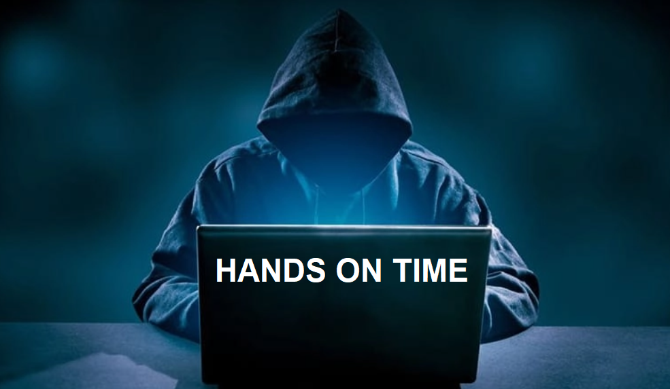
Google Dorking Commands
Google hacking, also known as Google Dorking, is a computer hacking technique. It uses advanced Google search operators to find security holes in the configuration and code that websites use. It is also useful for retrieving hidden information not easily accessible by the public.
Google Dorking involves using advanced operators in the Google search engine to locate specific text strings within search results. Some of the more popular examples are finding specific versions of vulnerable web applications.

Slide 49
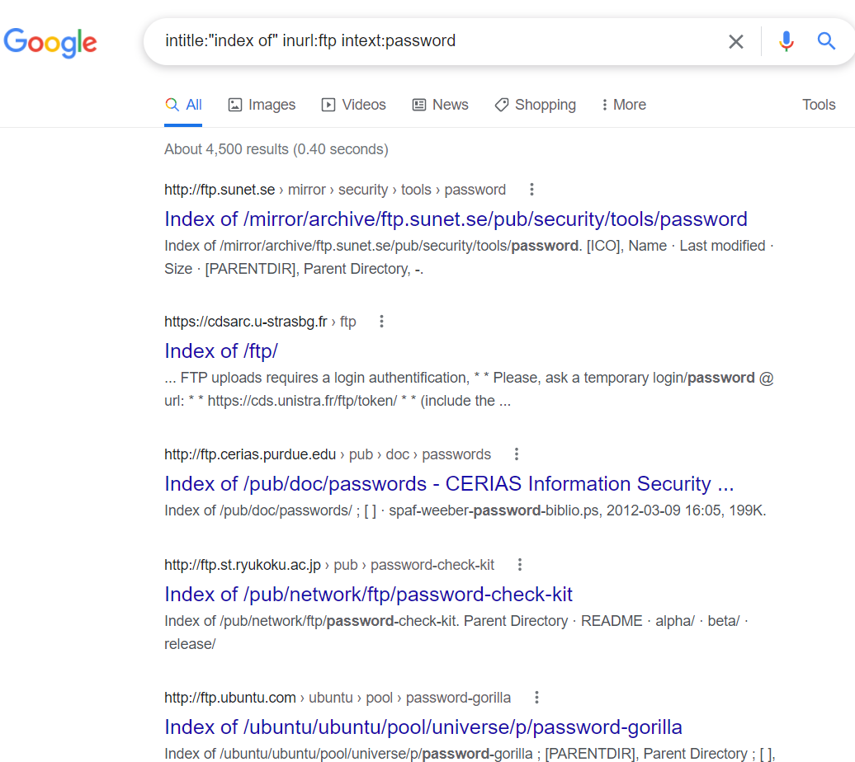
Finding exposed FTP servers
Google can index open FTP servers. Use the following Google Dork to find open FTP servers.
intitle:"index of" inurl:ftp
To make the query more interesting, we can add the "intext" Google Dork, which is used to locate a specific word within the returned pages

Slide 50
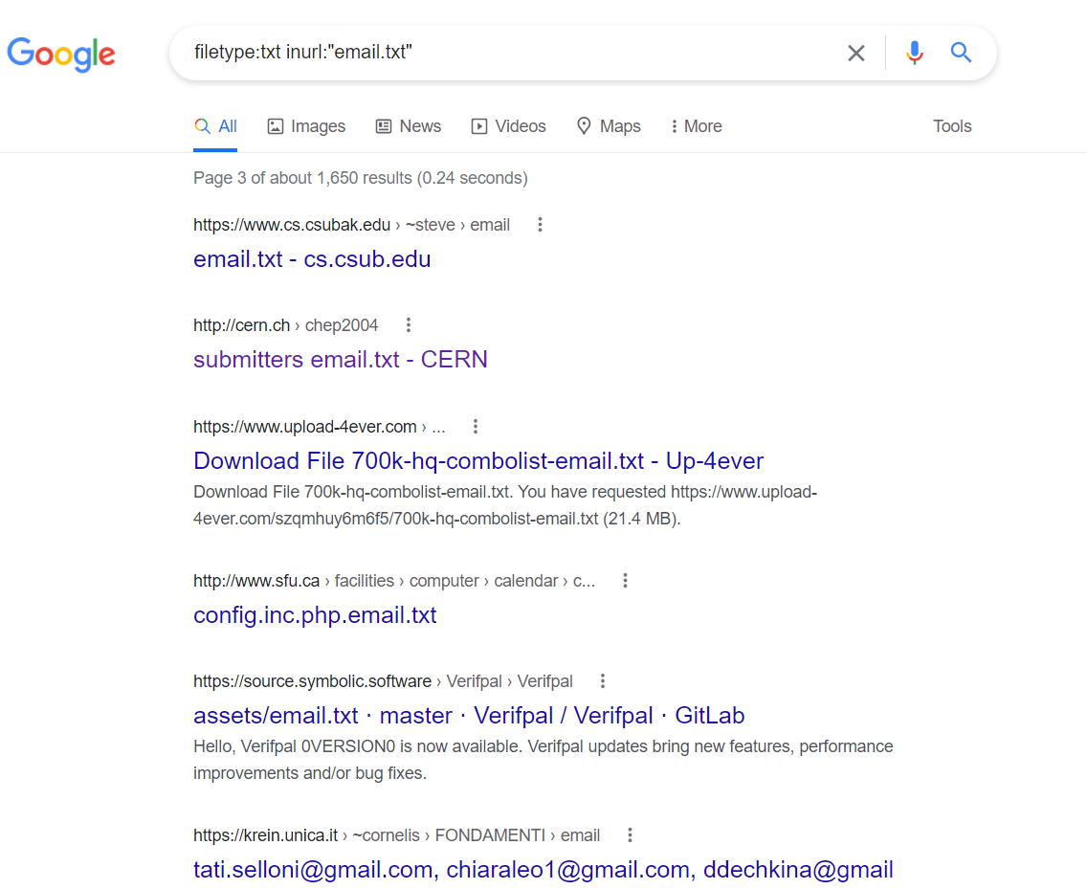
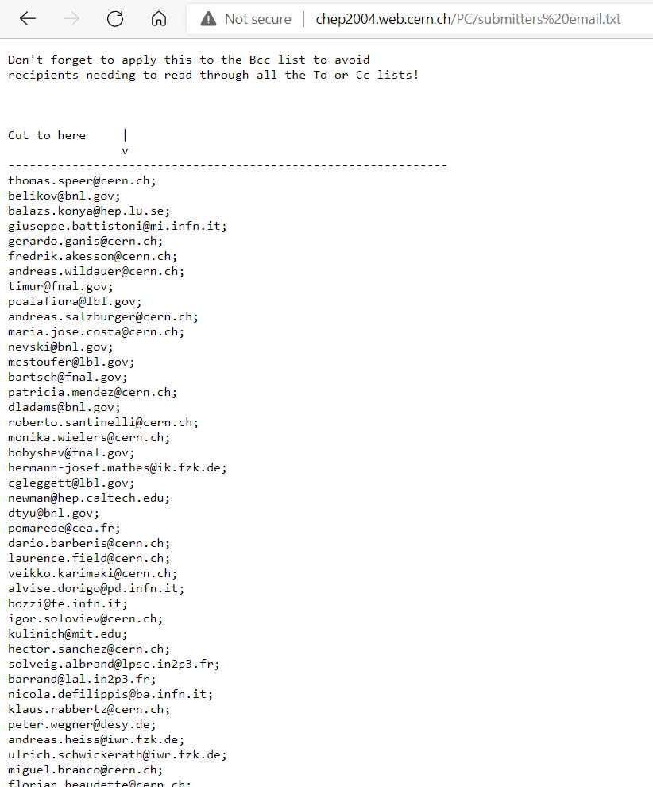
Find email lists
It is relatively easy to find email lists using Google Dorks. In the following example, we are going to find text files that contain email lists.
filetype:txt inurl:"email.txt"

Slide 51
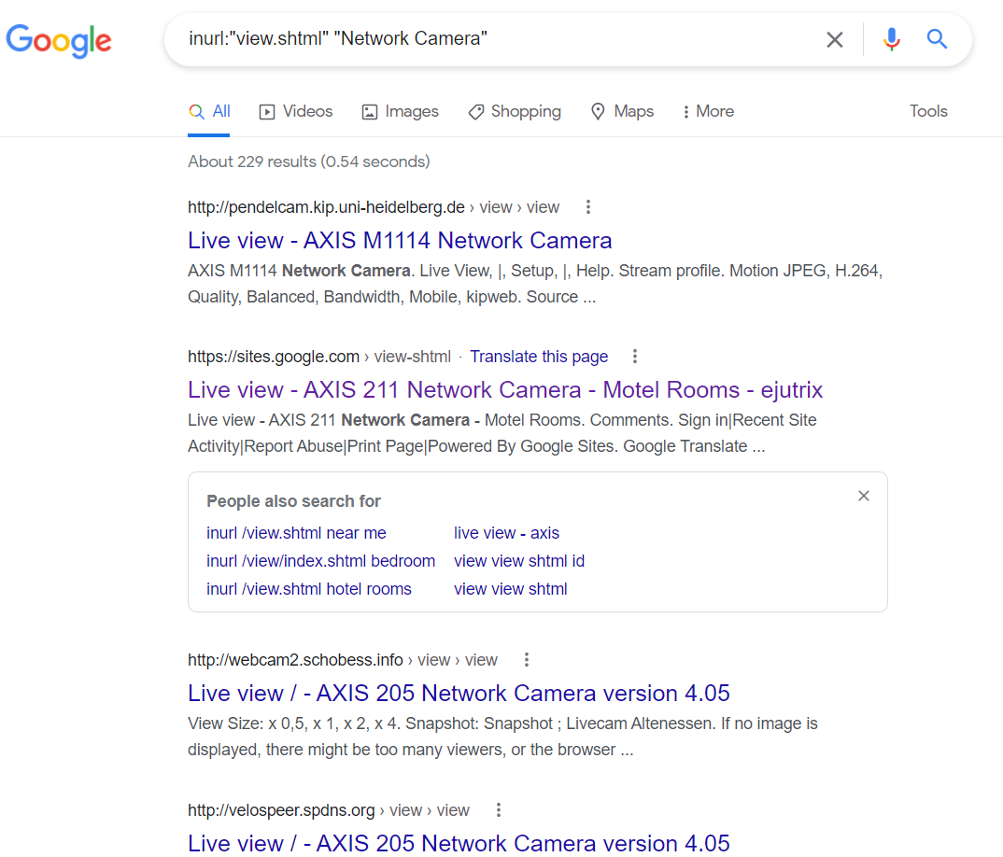
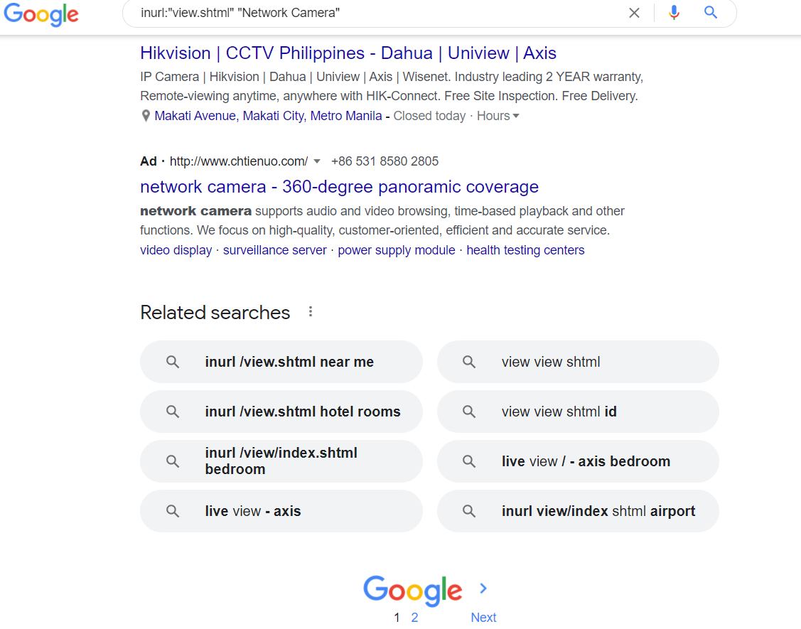
Live cameras
We can use Google to find open cameras that are not access restricted by IP address. The following Google dorks retrieve live cameras web pages.
inurl:"view.shtml" "Network Camera"
"Camera Live Image" inurl:"guestimage.html"

Slide 52
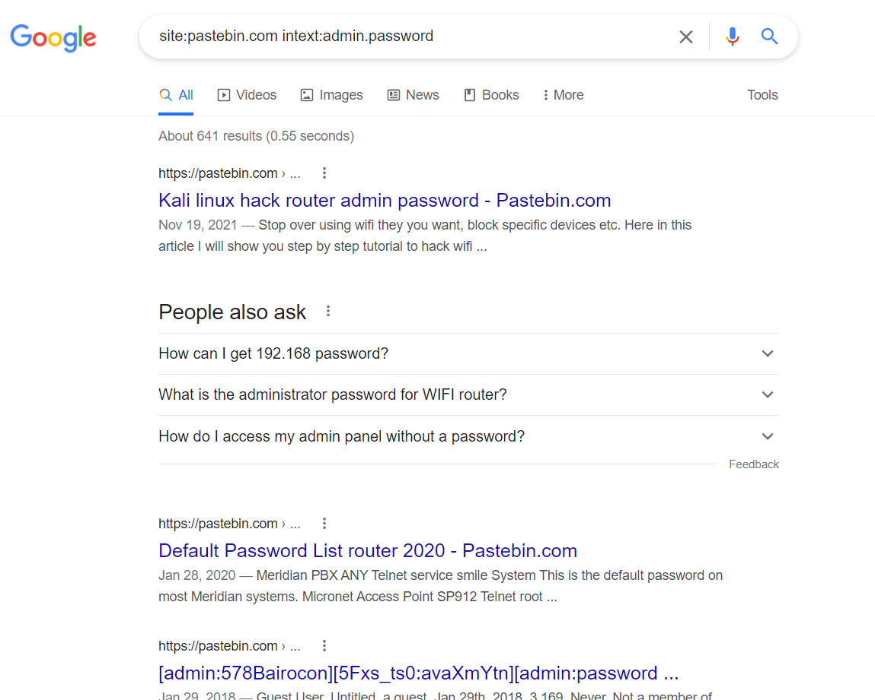
Finding passwords
Finding passwords is the most attractive task for both legitimate and ill-intentioned online searchers. The following Google Dorks retrieve exposed passwords.
site:pastebin.com intext:admin.password (find the text "admin.password" in the Pastebin website; this site is used by hackers to publish sensitive leaked information)

Slide 53
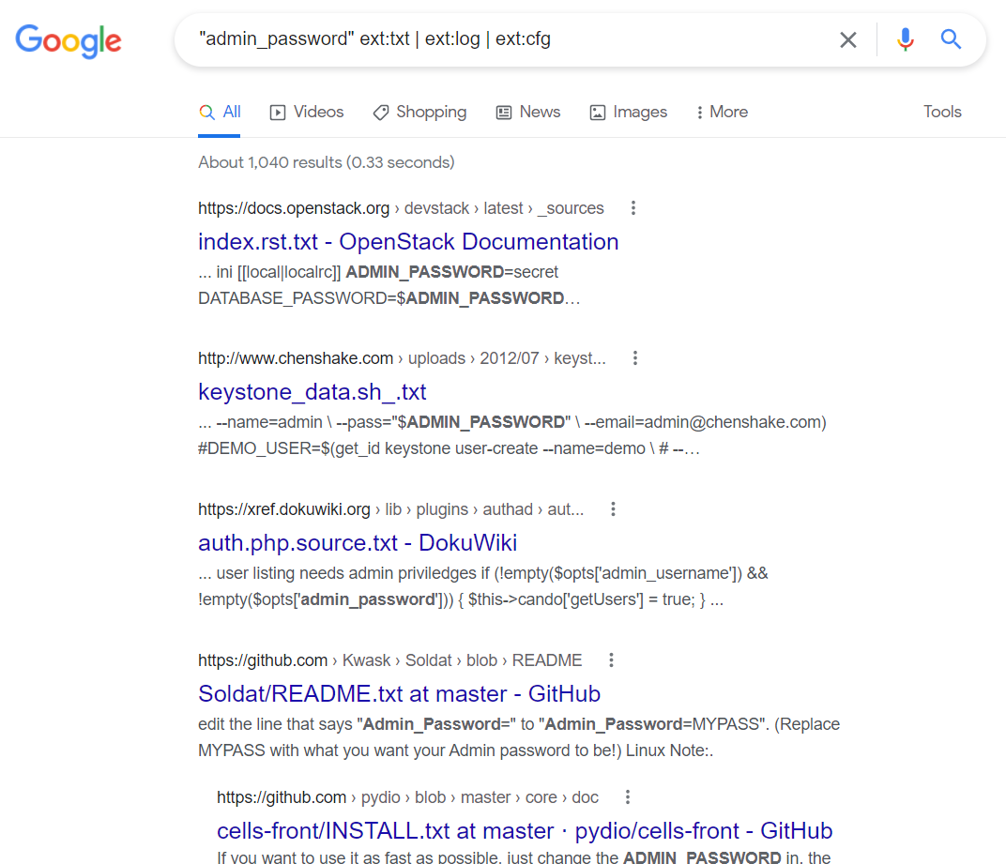
"admin_password" ext:txt | ext:log | ext:cfg (find the text “admin-password” in exposed files of the following types: TXT, LOG, CFG)

Slide 54
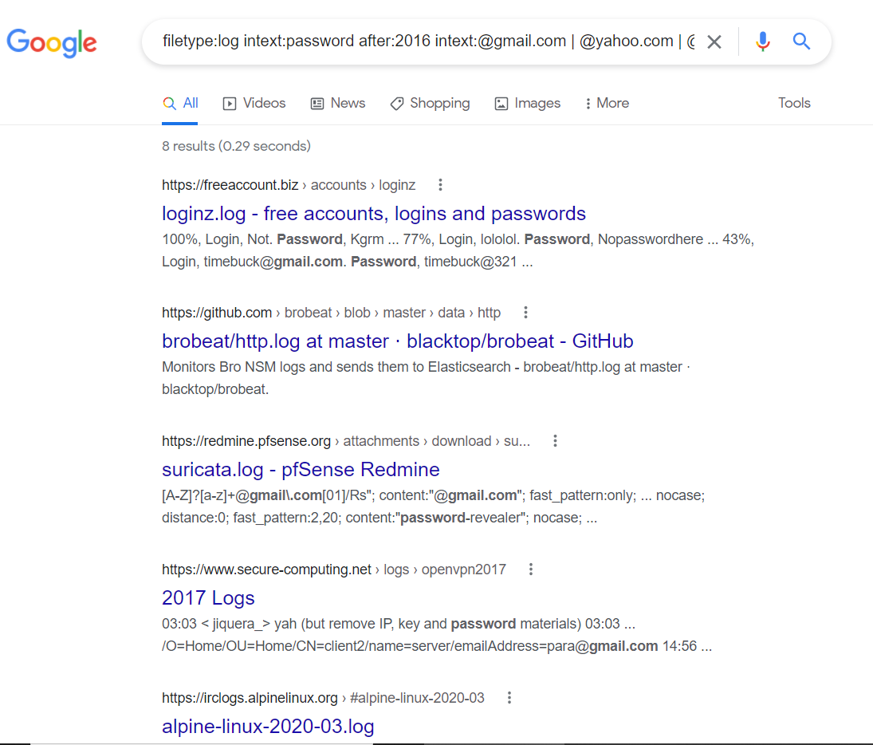
filetype:log intext:password after:2016 intext:@gmail.com | @yahoo.com | @hotmail.com (search for all files of type "log" that contain the word "password" within them, are indexed after 2016, and contain any of the following text in their body: @gmail.com, @yahoo.com, or @hotmail.com)

Slide 55
Other advanced Google Dorks can be found in the following list. Try them on your own to discover what each one returns.
site:static.ow.ly/docs/ intext:@gmail.com | Password
filetype:sql intext:wp_users phpmyadmin
intext:"Dumping data for table orders"
"Index of /wp-content/uploads/backupbuddy_backups" zip
Zixmail inurl:/s/login?
inurl:/remote/login/ intext:"please login"|intext:"FortiToken clock drift detected"
inurl:/WebInterface/login.html
inurl:dynamic.php?page=mailbox
inurl:/sap/bc/webdynpro/sap/ | "sap-system-login-oninputprocessing"
intext:"Powered by net2ftp"

Slide 56
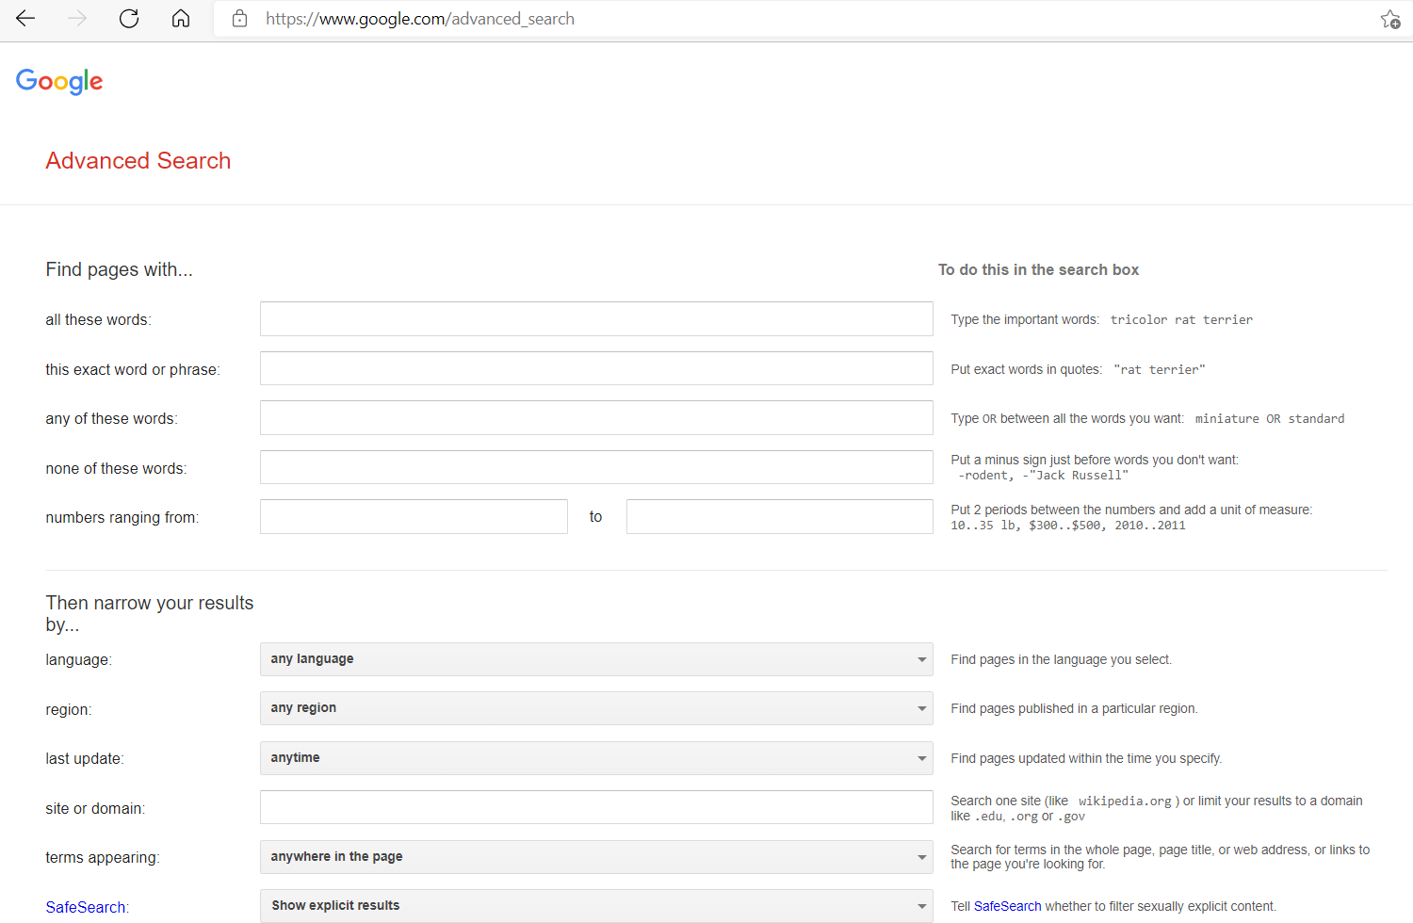
Advanced Google Dorks
Writing Google Dorks is not a straightforward process like the simple search query entered on Google's main page. The process takes some time to get used to. However, the returned results can be worth the effort. Before we begin writing advanced Dorks, it is worth noting that Google offers a powerful Advanced Search (https://www.google.com/advanced_search) that gives more specific search results with an easy to use graphical user interface

Slide 57
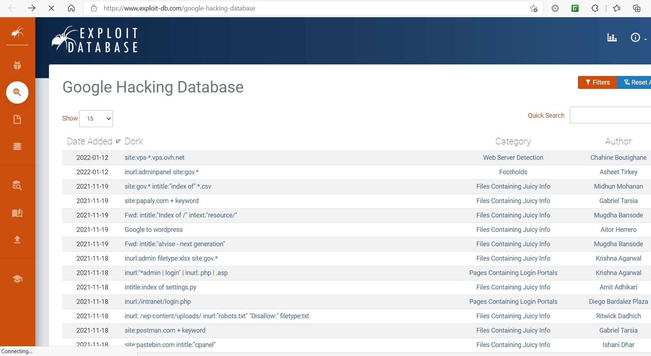
Google Dorks lists
There are different places to find ready to use Google Dorks. The first place is Google Hacking Database. This is a free public database containing thousands of Google Dorks for finding sensitive publicly available information
https://www.exploit-db.com/google-hacking-database

Slide 58
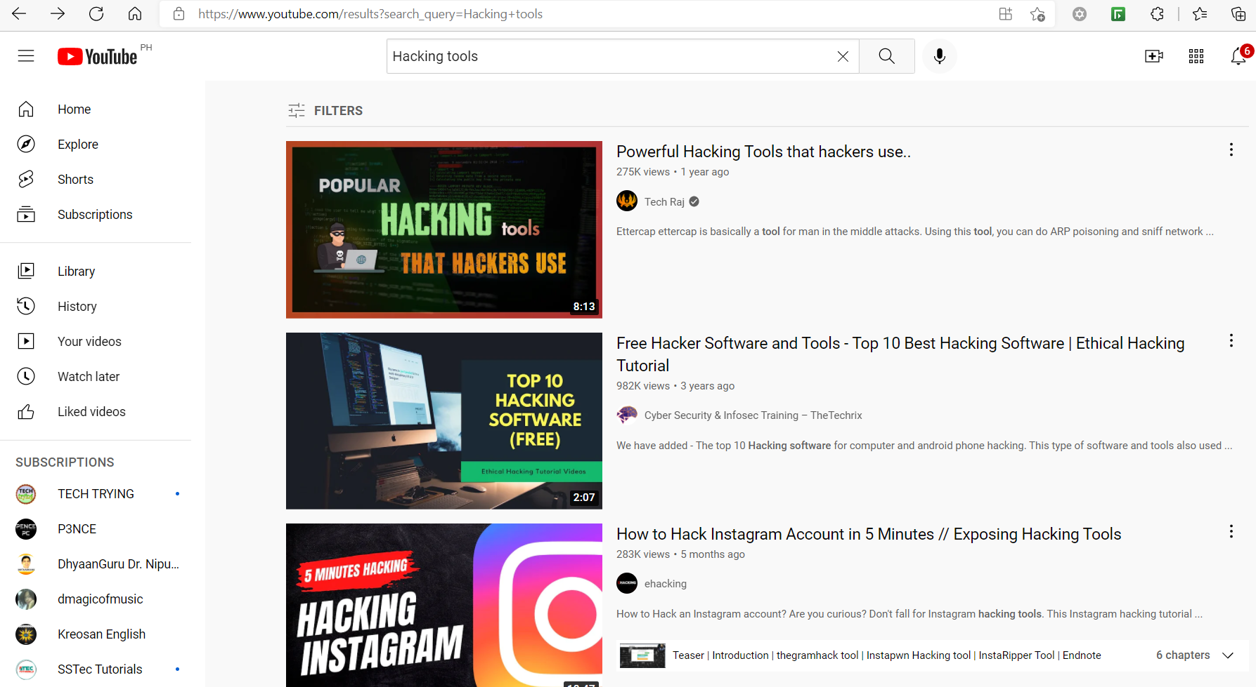
Looking for Hacking Tools

Slide 59
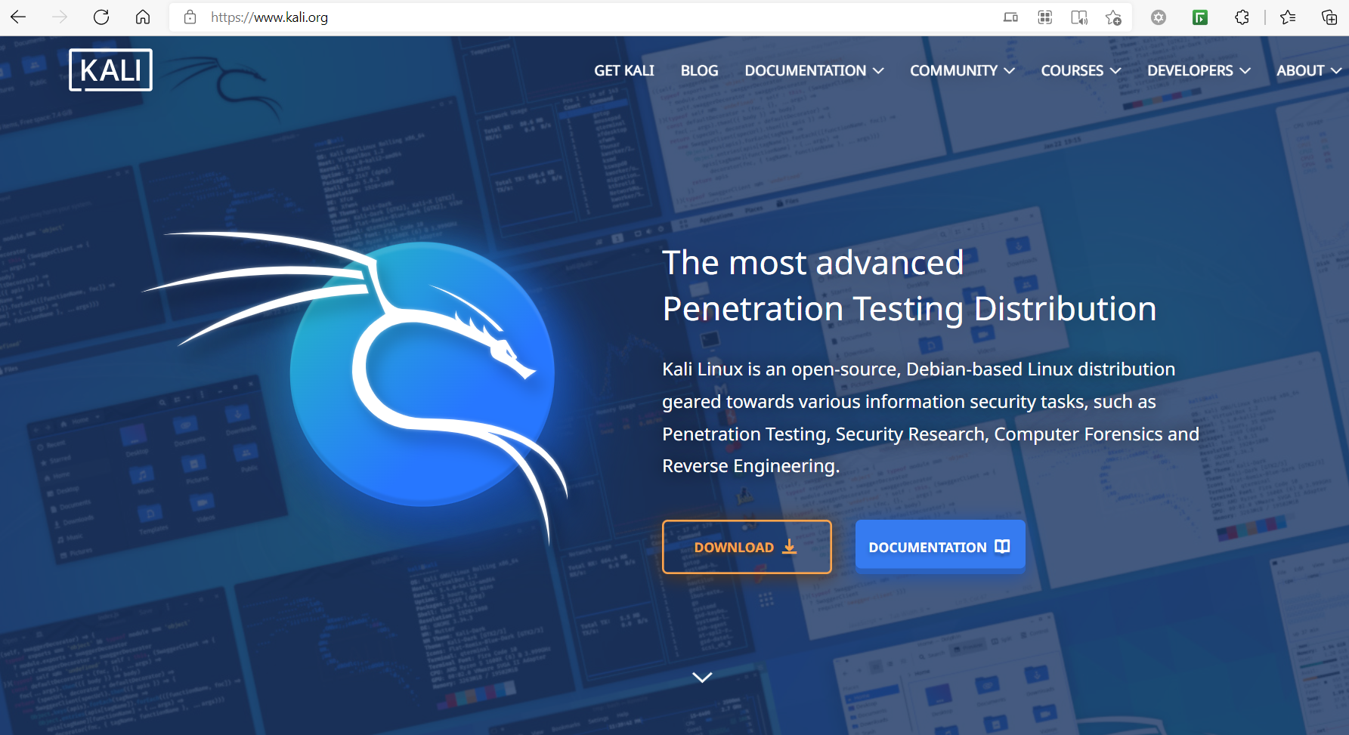
https://www.kali.org/

Slide 60
Let’s now talk anything under the SUN

Slide 61
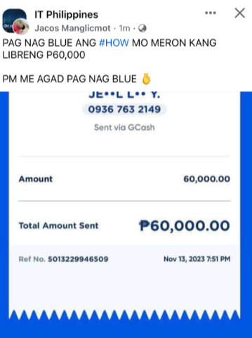



Slide 62



Slide 63



Slide 64



Slide 65



Slide 66


